Slide 1

Work Life: Fishing (Color)
Notes:
These images are distributed with the August 2024 issue of the BiblePlaces Newsletter. They come from the photographic collection of Eric Matson donated to the U.S. Library of Congress, organized and published by BiblePlaces.com in The American Colony and Eric Matson Collection in the Historic Views of the Holy Land series. The image colorization was done through Palette; as with much AI technology today, there remains significant room for improvement. Quotations come from historic sources listed in the bibliography on the last slide.
For more historic photographs of the biblical world, visit www.bibleplaces.com/historicviews or www.lifeintheholyland.com.
This presentation is copyrighted by Todd Bolen. Permission to use is granted for personal and educational purposes. Commercial use or re-distribution requires written permission.

Slide 2
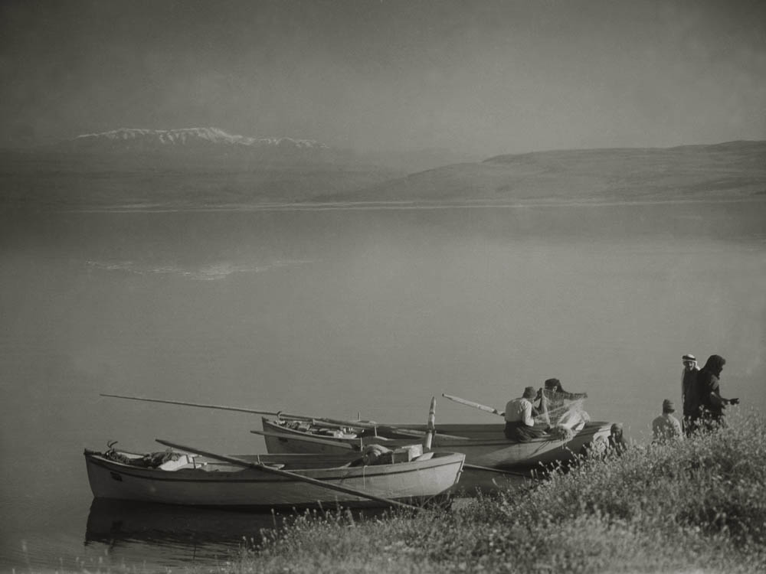
Sea of Galilee with fishermen
Sea of Galilee with fishermen
Notes:
“The Bible speaks of the fish of the Nile (Is. xix. 8), and of the sea (Neh. xii. 16; Hos iv. 3; Zeph. i. 3), but the most frequent allusions to the art of fishing are in connection with the Sea of Galilee. These of course are fresh-water fish. The lake contains vast quantities of them, and the danger of the breaking net and sinking boat is still at times encountered (Luke v. 6)” (Mackie 1898: 74-75).
Date of photograph: April 30, 1938
mat03691

Slide 3
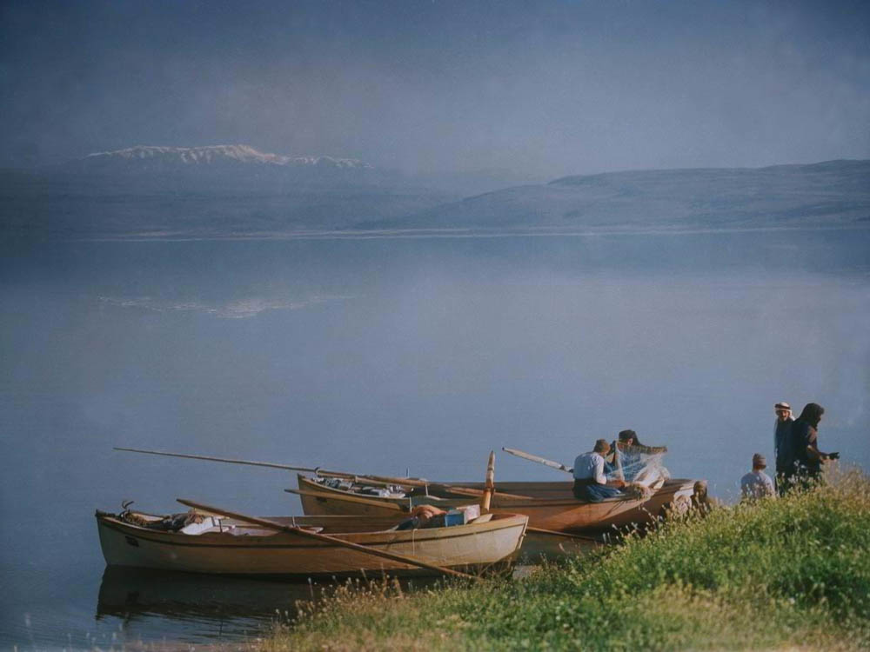
Sea of Galilee with fishermen
Sea of Galilee with fishermen
Notes:
“The Bible speaks of the fish of the Nile (Is. xix. 8), and of the sea (Neh. xii. 16; Hos iv. 3; Zeph. i. 3), but the most frequent allusions to the art of fishing are in connection with the Sea of Galilee. These of course are fresh-water fish. The lake contains vast quantities of them, and the danger of the breaking net and sinking boat is still at times encountered (Luke v. 6)” (Mackie 1898: 74-75).
Date of photograph: April 30, 1938
mat03691col

Slide 4
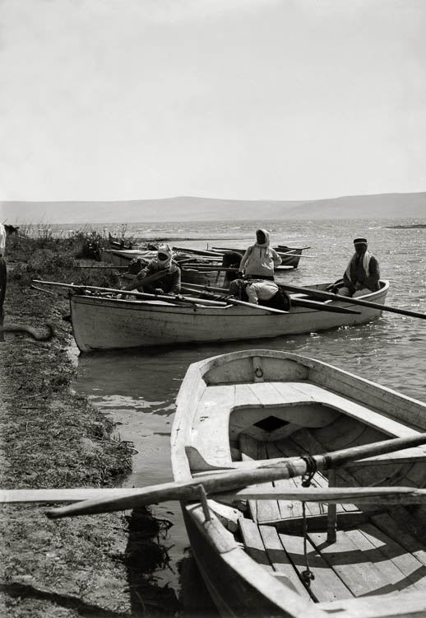
Fishermen in boats near Jordan mouth
Fishermen in boats near Jordan mouth
Notes:
Date of photograph: between 1900 and 1920
mat05162

Slide 5
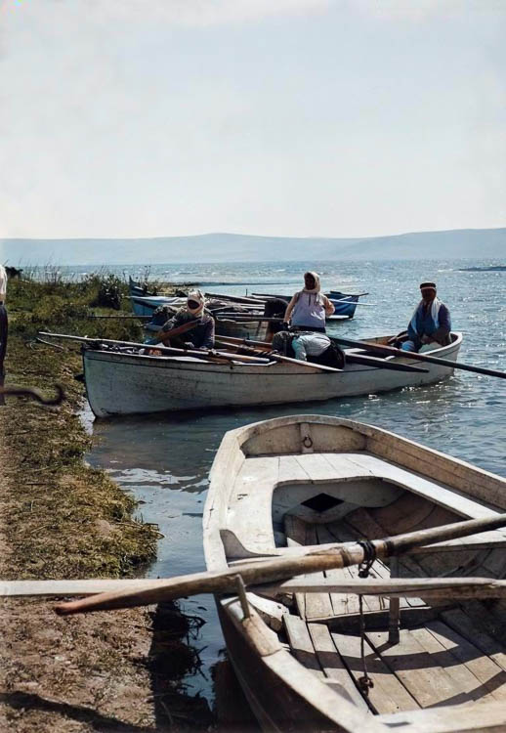
Fishermen in boats near Jordan mouth
Fishermen in boats near Jordan mouth
Notes:
Date of photograph: between 1900 and 1920
mat05162col

Slide 6
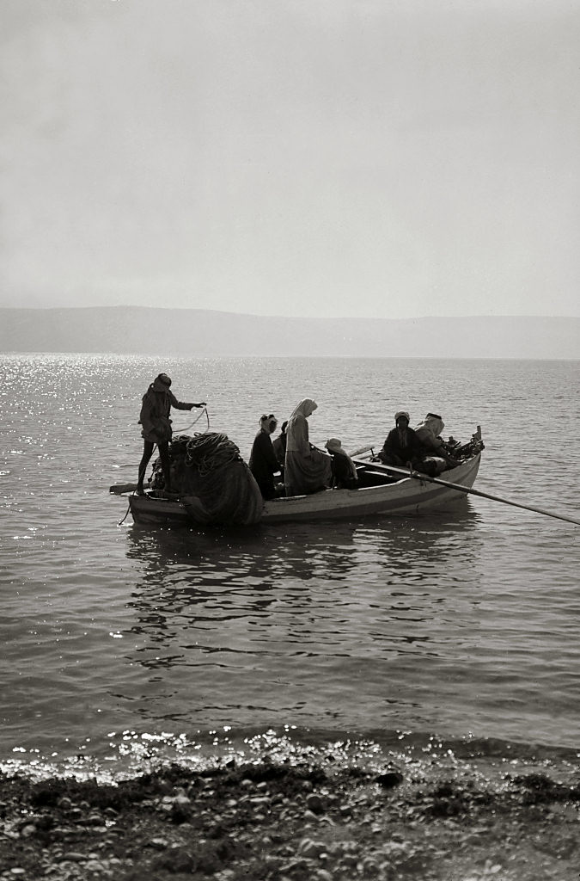
Fishermen setting forth in boat
Fishermen setting forth in boat
Notes:
Location of photograph: Sea of Galilee
Date of photograph: between 1900 and 1920
mat05683

Slide 7
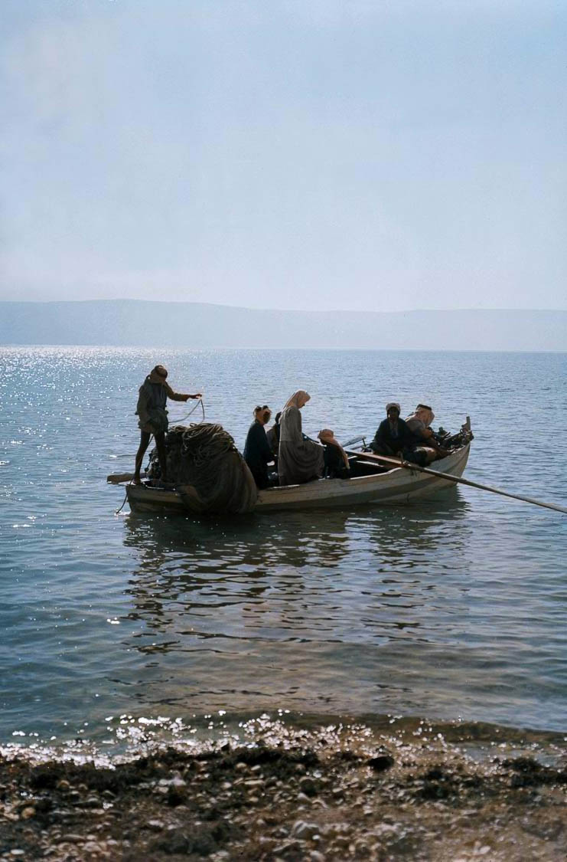
Fishermen setting forth in boat
Fishermen setting forth in boat
Notes:
Location of photograph: Sea of Galilee
Date of photograph: between 1900 and 1920
mat05683col

Slide 8
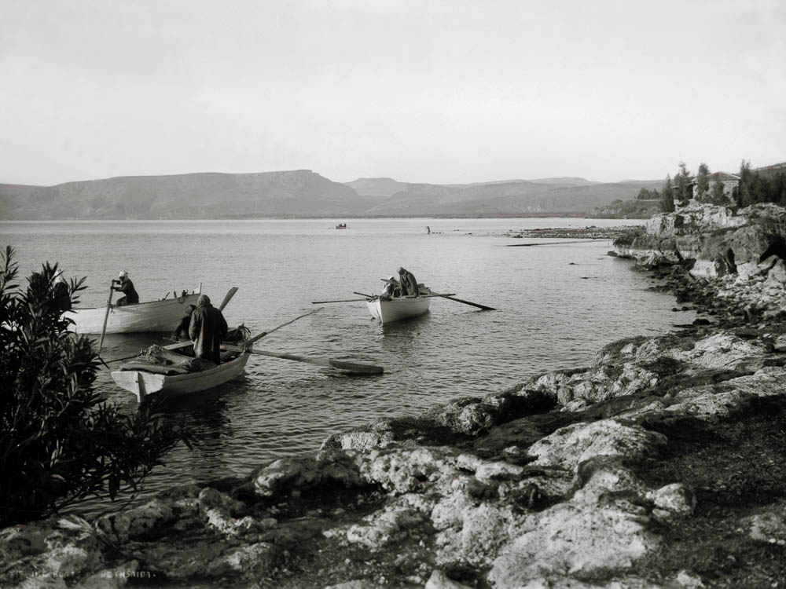
Fishing boats on Sea of Galilee
Fishing boats on Sea of Galilee
Notes:
“But the fish and the fisheries of the Sea of Galilee had then a world-wide reputation. The choicest kinds abounded in this lake, and some varieties existed here similar to those found in the Nile. Tarichæa was noted for its extensive “fishfactories,” and from the business of fishing more than one of the towns upon the shore are said to have derived their names. People came hither even from Jerusalem, especially just before the great feasts, to fish in these waters, and thus provide means of support for the multitudes that, on those occasions, flocked to the Temple” (Wilson 1881: 2: 80).
Date of photograph: between 1900 and 1920
mat05682

Slide 9
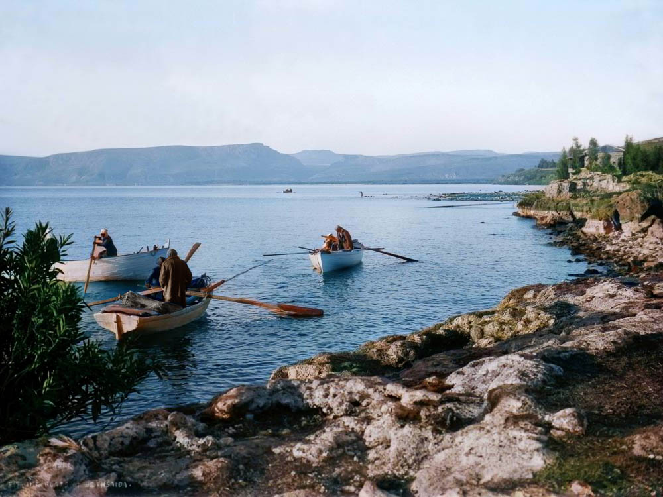
Fishing boats on Sea of Galilee
Fishing boats on Sea of Galilee
Notes:
“But the fish and the fisheries of the Sea of Galilee had then a world-wide reputation. The choicest kinds abounded in this lake, and some varieties existed here similar to those found in the Nile. Tarichæa was noted for its extensive “fishfactories,” and from the business of fishing more than one of the towns upon the shore are said to have derived their names. People came hither even from Jerusalem, especially just before the great feasts, to fish in these waters, and thus provide means of support for the multitudes that, on those occasions, flocked to the Temple” (Wilson 1881: 2: 80).
Date of photograph: between 1900 and 1920
mat05682col

Slide 10
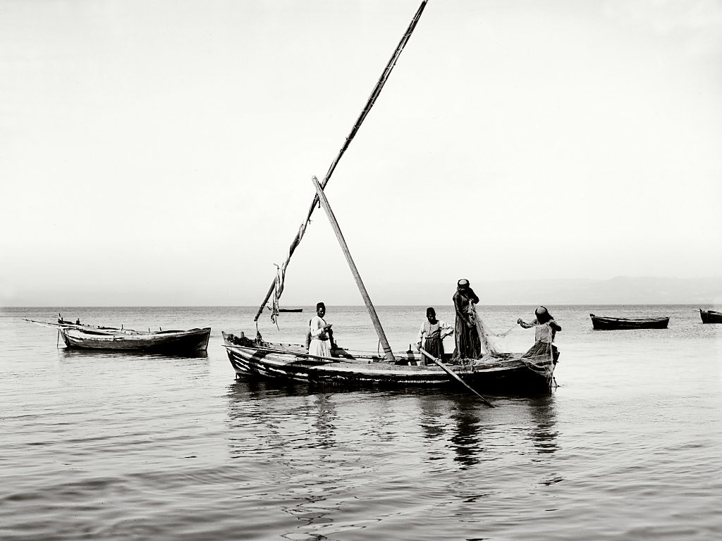
Fishermen on Sea of Galilee
Fishermen on Sea of Galilee
Notes:
“Off Tiberias yet another method has been adopted in recent years. It was found that the musht, who are a very wily fish and the most difficult to catch, frequently managed to jump over the floating edge of the draw-net after they had been surrounded, so a new device was contrived. Two boats, as usual, act in concert, their movements being directed by a man stationed on a point of the shore high above the water, who, from this vantage ground, is able to detect the presence of a shoal of musht. Proceeding to the spot indicated, the fishermen of one boat quickly drop the long jarf in a circle round the shoal, while those in the second boat pay out an m’batten—without its lead weights—all round the circle, keeping it stretched out flat on the level of the water by means of wooden rods, and loosely fixing it at points to the floating edge of the jarf. The musht, finding the circle closing in round them, jump the edge and land on, and are entangled in, this floating net. The jarf may now be dragged to land. As the bottom of the lake is full of great stones, some of the fishermen dive in and assist the progress of the weighted side over these obstructions. When the circle is very full of fish the shabakeh is used again and again to partially clear the jarf by securing the enclosed musht; under such circumstances this net is often brought up an almost solid mass of fish” (Masterman 1908: 46-47).
Date of photograph: between 1898 and 1914
mat07015

Slide 11
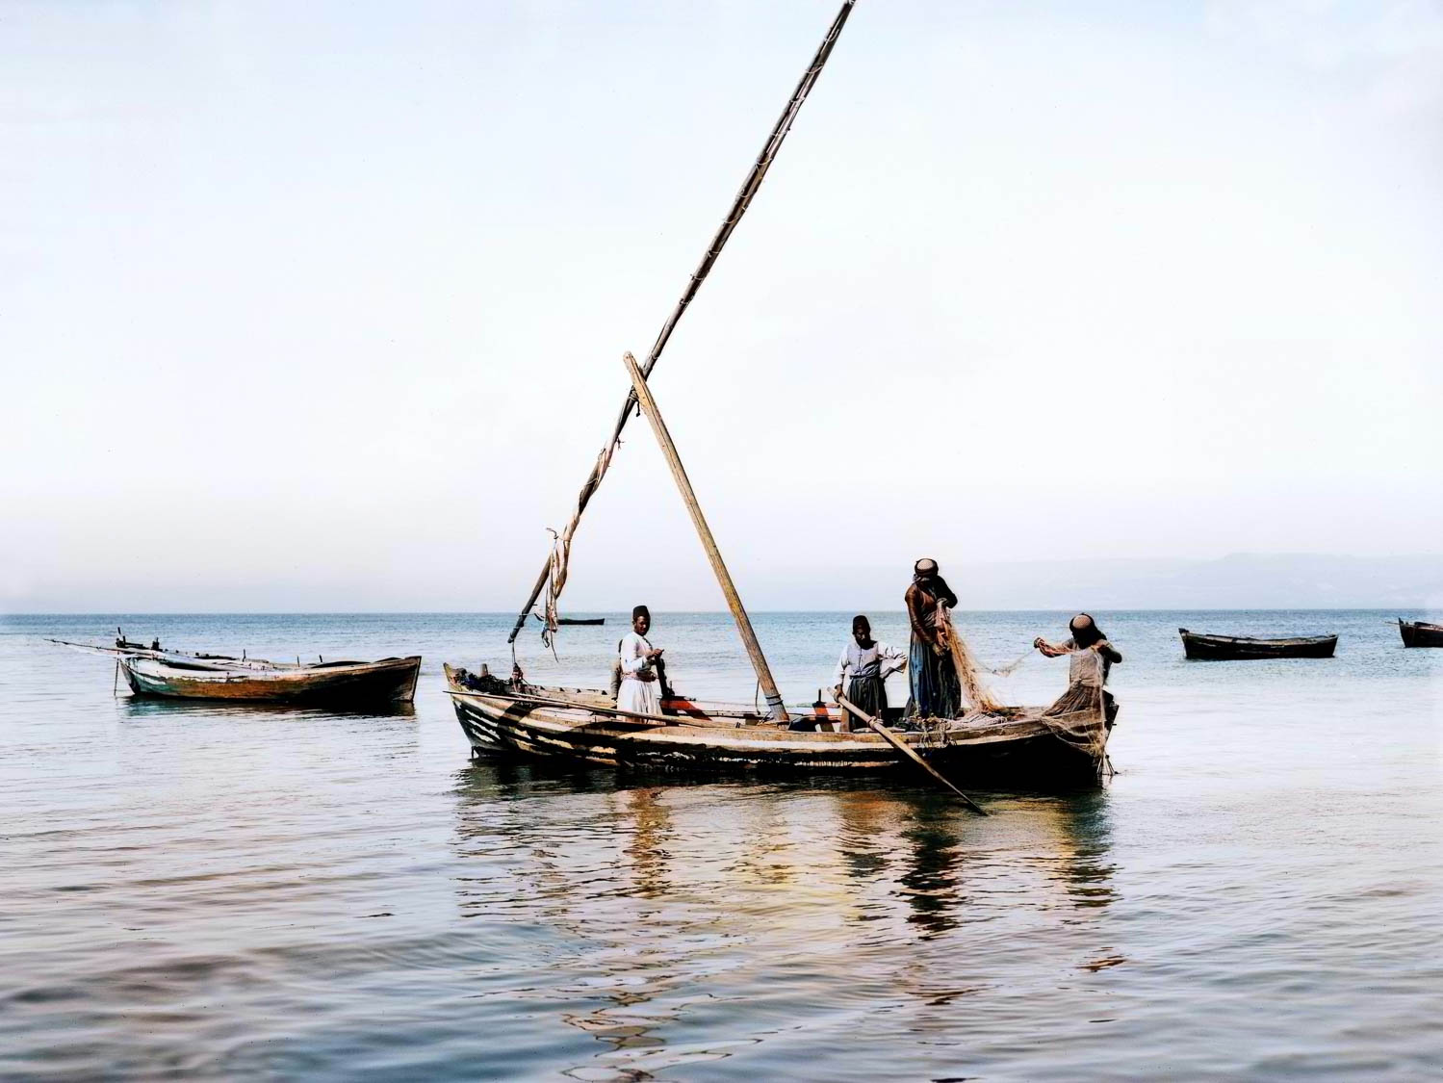
Fishermen on Sea of Galilee
Fishermen on Sea of Galilee
Notes:
“Off Tiberias yet another method has been adopted in recent years. It was found that the musht, who are a very wily fish and the most difficult to catch, frequently managed to jump over the floating edge of the draw-net after they had been surrounded, so a new device was contrived. Two boats, as usual, act in concert, their movements being directed by a man stationed on a point of the shore high above the water, who, from this vantage ground, is able to detect the presence of a shoal of musht. Proceeding to the spot indicated, the fishermen of one boat quickly drop the long jarf in a circle round the shoal, while those in the second boat pay out an m’batten—without its lead weights—all round the circle, keeping it stretched out flat on the level of the water by means of wooden rods, and loosely fixing it at points to the floating edge of the jarf. The musht, finding the circle closing in round them, jump the edge and land on, and are entangled in, this floating net. The jarf may now be dragged to land. As the bottom of the lake is full of great stones, some of the fishermen dive in and assist the progress of the weighted side over these obstructions. When the circle is very full of fish the shabakeh is used again and again to partially clear the jarf by securing the enclosed musht; under such circumstances this net is often brought up an almost solid mass of fish” (Masterman 1908: 46-47).
Date of photograph: between 1898 and 1914
mat07015col

Slide 12
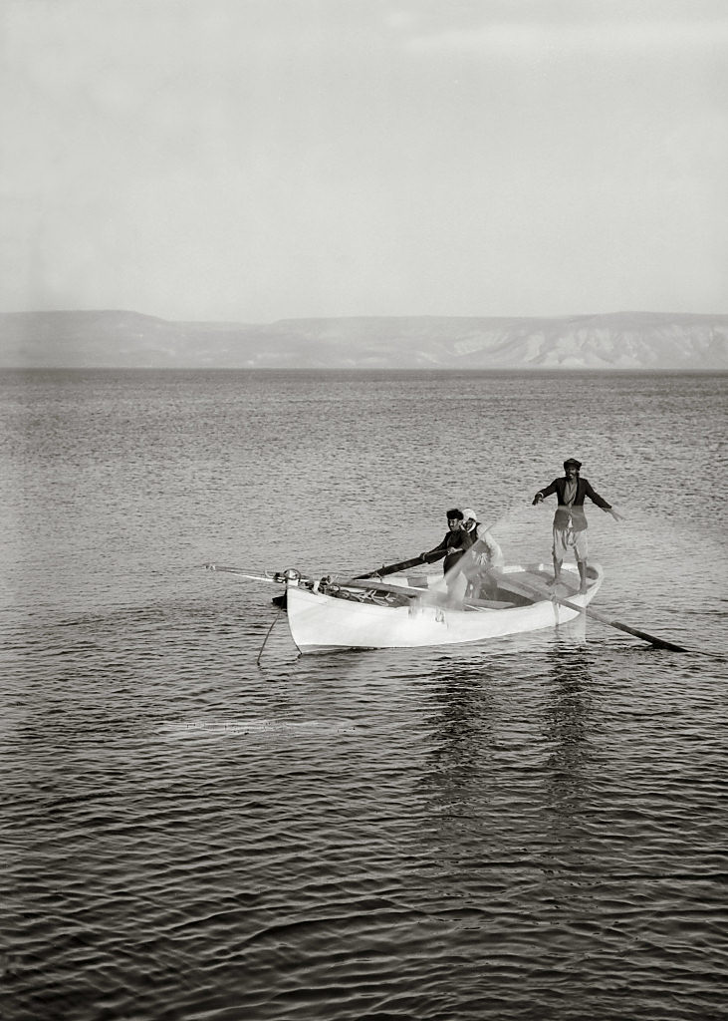
Fisherman casting net
Fisherman casting net
Notes:
“Peter speaks of toiling all night, and certain kinds of fishing are carried on at night. It is a beautiful sight. With blazing torch the bat glides over the flashing sea, and the men stand gazing keenly into it until their prey is sighted, when, quick as thought, they fling their net or fly their spear, and often you see the tired fishermen come sullenly into harbor in the morning, having toiled all night in vain. Indeed, every kind of fishing is uncertain. A dozen times the angler jerks out a bare hook; the hand-net closes down on nothing; the drag-net brings in only weeds; the bag-net comes up empty. And then, again, every throw is successful-every net is full; and frequently without any other apparent reason than that of throwing it on the right side of the ship instead of the left, as it happened to the disciples here on the Lake of Tiberias” (Thomson 1882: 349).
Location of photograph: Sea of Galilee
Date of photograph: between 1934 and 1939
mat04201

Slide 13
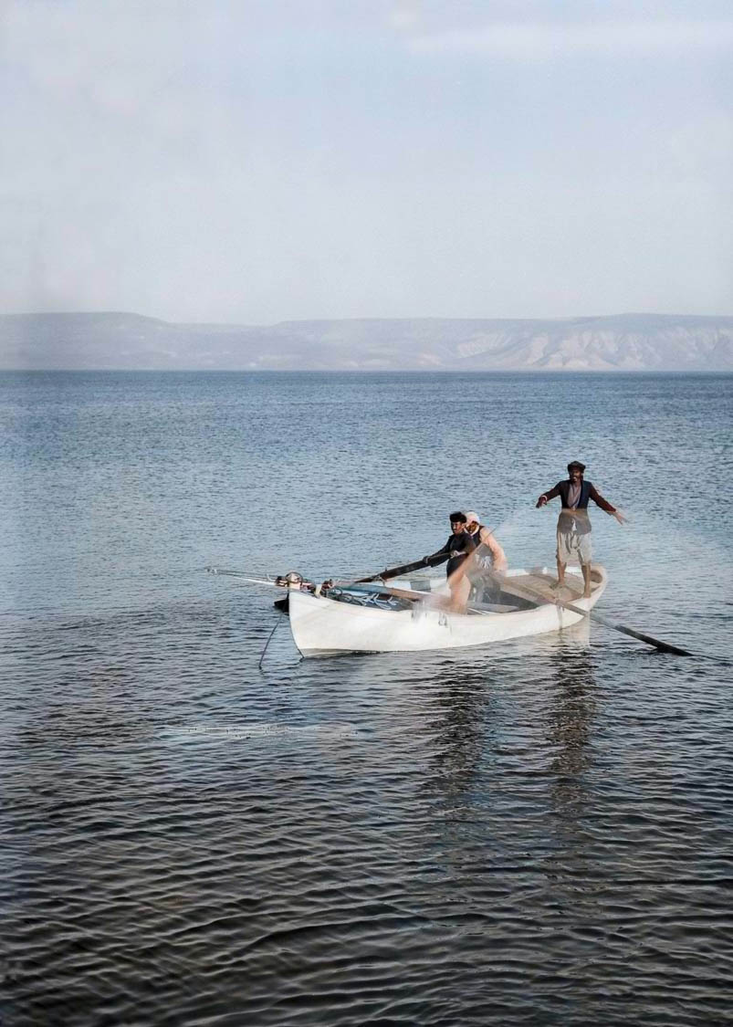
Fisherman casting net
Fisherman casting net
Notes:
“Peter speaks of toiling all night, and certain kinds of fishing are carried on at night. It is a beautiful sight. With blazing torch the bat glides over the flashing sea, and the men stand gazing keenly into it until their prey is sighted, when, quick as thought, they fling their net or fly their spear, and often you see the tired fishermen come sullenly into harbor in the morning, having toiled all night in vain. Indeed, every kind of fishing is uncertain. A dozen times the angler jerks out a bare hook; the hand-net closes down on nothing; the drag-net brings in only weeds; the bag-net comes up empty. And then, again, every throw is successful-every net is full; and frequently without any other apparent reason than that of throwing it on the right side of the ship instead of the left, as it happened to the disciples here on the Lake of Tiberias” (Thomson 1882: 349).
Location of photograph: Sea of Galilee
Date of photograph: between 1934 and 1939
mat04201col

Slide 14
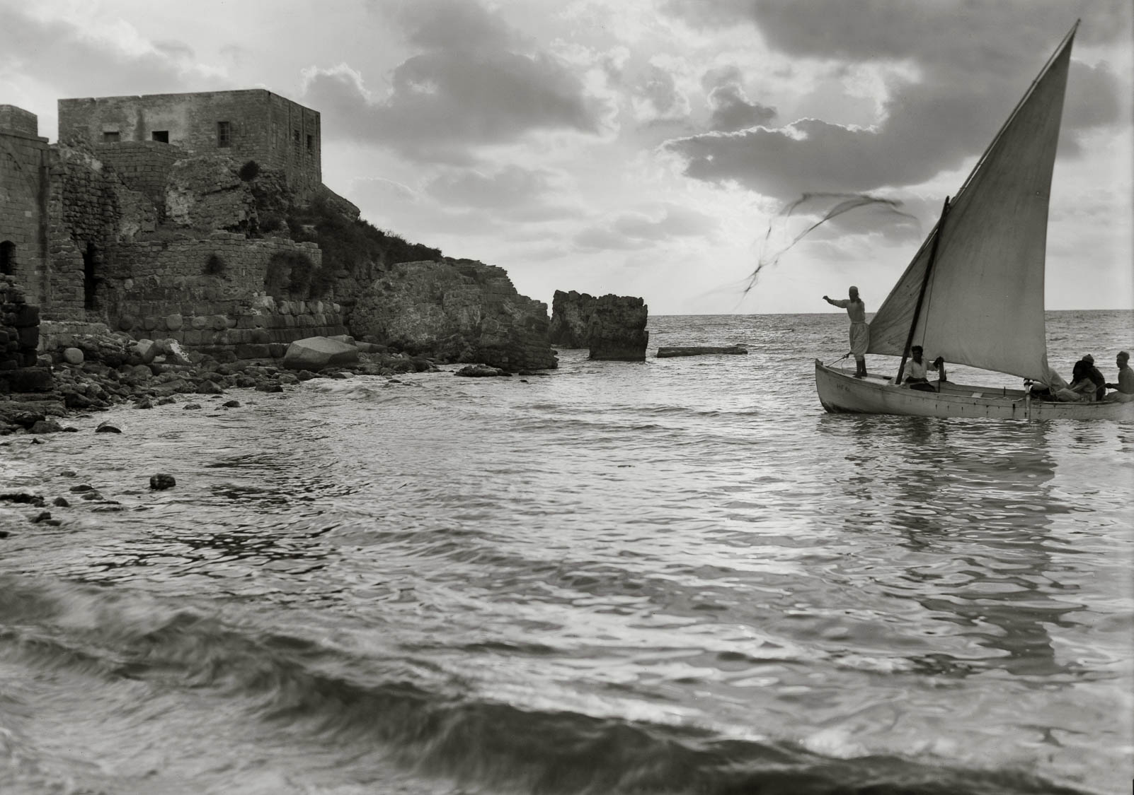
Fisherman throwing net at sunset
Fisherman throwing net at sunset
Notes:
“Then there is fishing with the hand-net. It is seen to best advantage along the coast from Beirût to Sidon and Tyre. The net is in shape like the top of a tent, with a long cord fastened to the apex. This is tied to the hand, and the net so disposed over the arm that, when thrown, it expands to its utmost circumference, around which are strung beads of lead to make it drip suddenly to the bottom. The fisherman, half bent, and more than half naked, keenly watches the playful surf, and there spies his game tumbling in carelessly towards him. Forward he leaps to meet it. Away goes the net, expanding as it flies, and its leaded circumference sinks to the bottom ere the fish are aware that its meshes have closed around them. By the aid of the cord the fisherman leisurely draws up the net, and secures the fish. Al this requires a keen eye and an active frame. He, too, must be patient, watchful and prompt to cast his net at the proper moment” (Thomson 1882: 348).
Location of photograph: Caesarea
Date of photograph: June 1938
mat04000

Slide 15
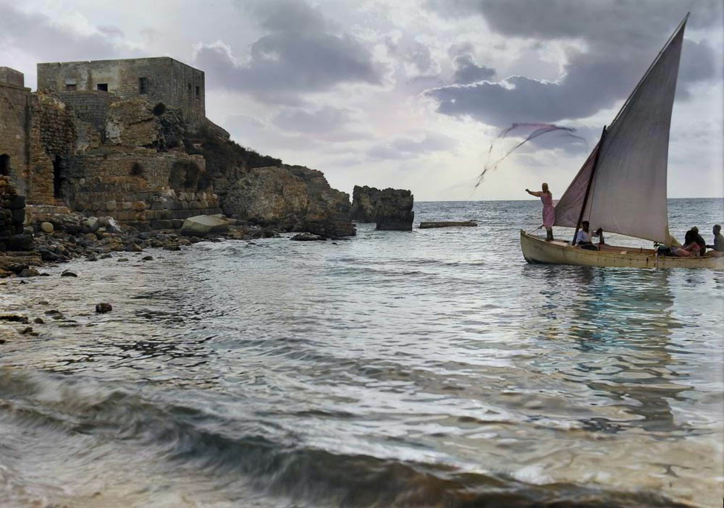
Fisherman throwing net at sunset
Fisherman throwing net at sunset
Notes:
“Then there is fishing with the hand-net. It is seen to best advantage along the coast from Beirût to Sidon and Tyre. The net is in shape like the top of a tent, with a long cord fastened to the apex. This is tied to the hand, and the net so disposed over the arm that, when thrown, it expands to its utmost circumference, around which are strung beads of lead to make it drip suddenly to the bottom. The fisherman, half bent, and more than half naked, keenly watches the playful surf, and there spies his game tumbling in carelessly towards him. Forward he leaps to meet it. Away goes the net, expanding as it flies, and its leaded circumference sinks to the bottom ere the fish are aware that its meshes have closed around them. By the aid of the cord the fisherman leisurely draws up the net, and secures the fish. Al this requires a keen eye and an active frame. He, too, must be patient, watchful and prompt to cast his net at the proper moment” (Thomson 1882: 348).
Location of photograph: Caesarea
Date of photograph: June 1938
mat04000col

Slide 16
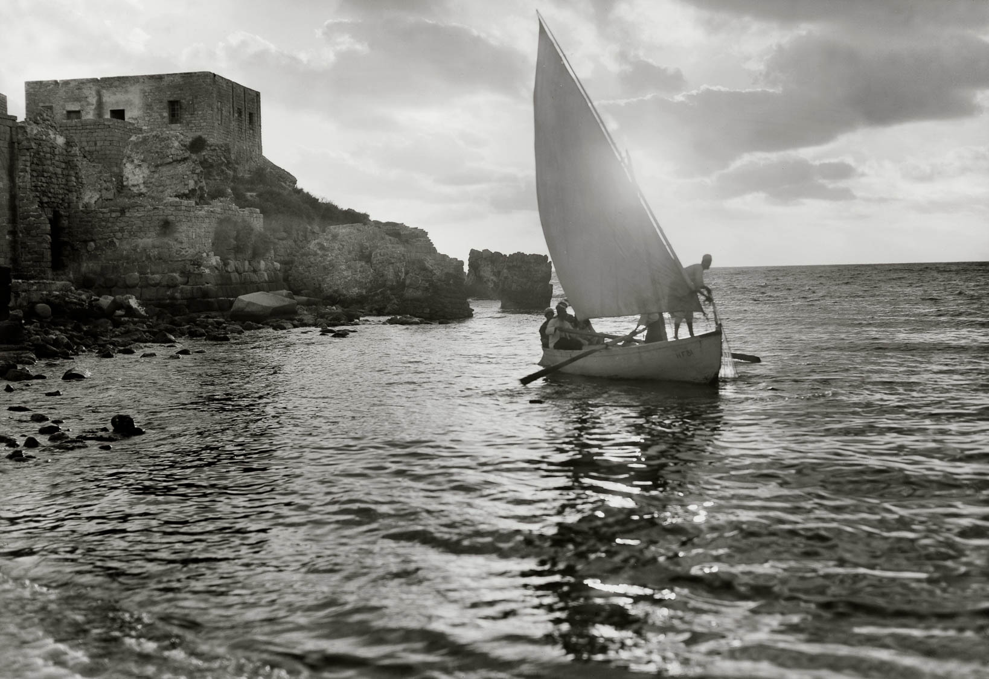
Fisherman drawing net at sunset
Fisherman drawing net at sunset
Notes:
Location of photograph: Caesarea
Date of photograph: June 1938
mat04001

Slide 17
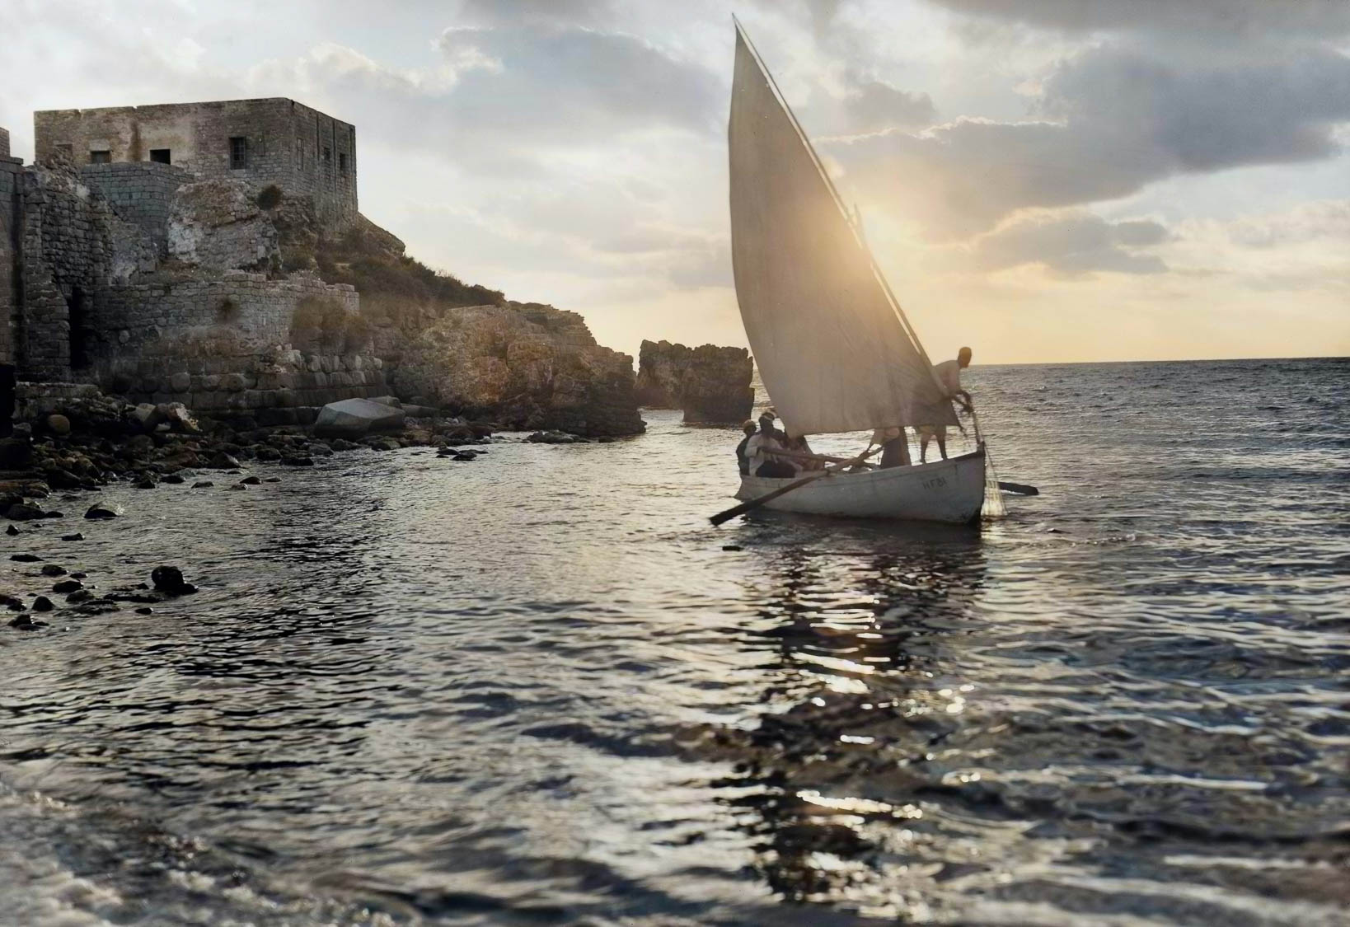
Fisherman drawing net at sunset
Fisherman drawing net at sunset
Notes:
Location of photograph: Caesarea
Date of photograph: June 1938
mat04001col

Slide 18
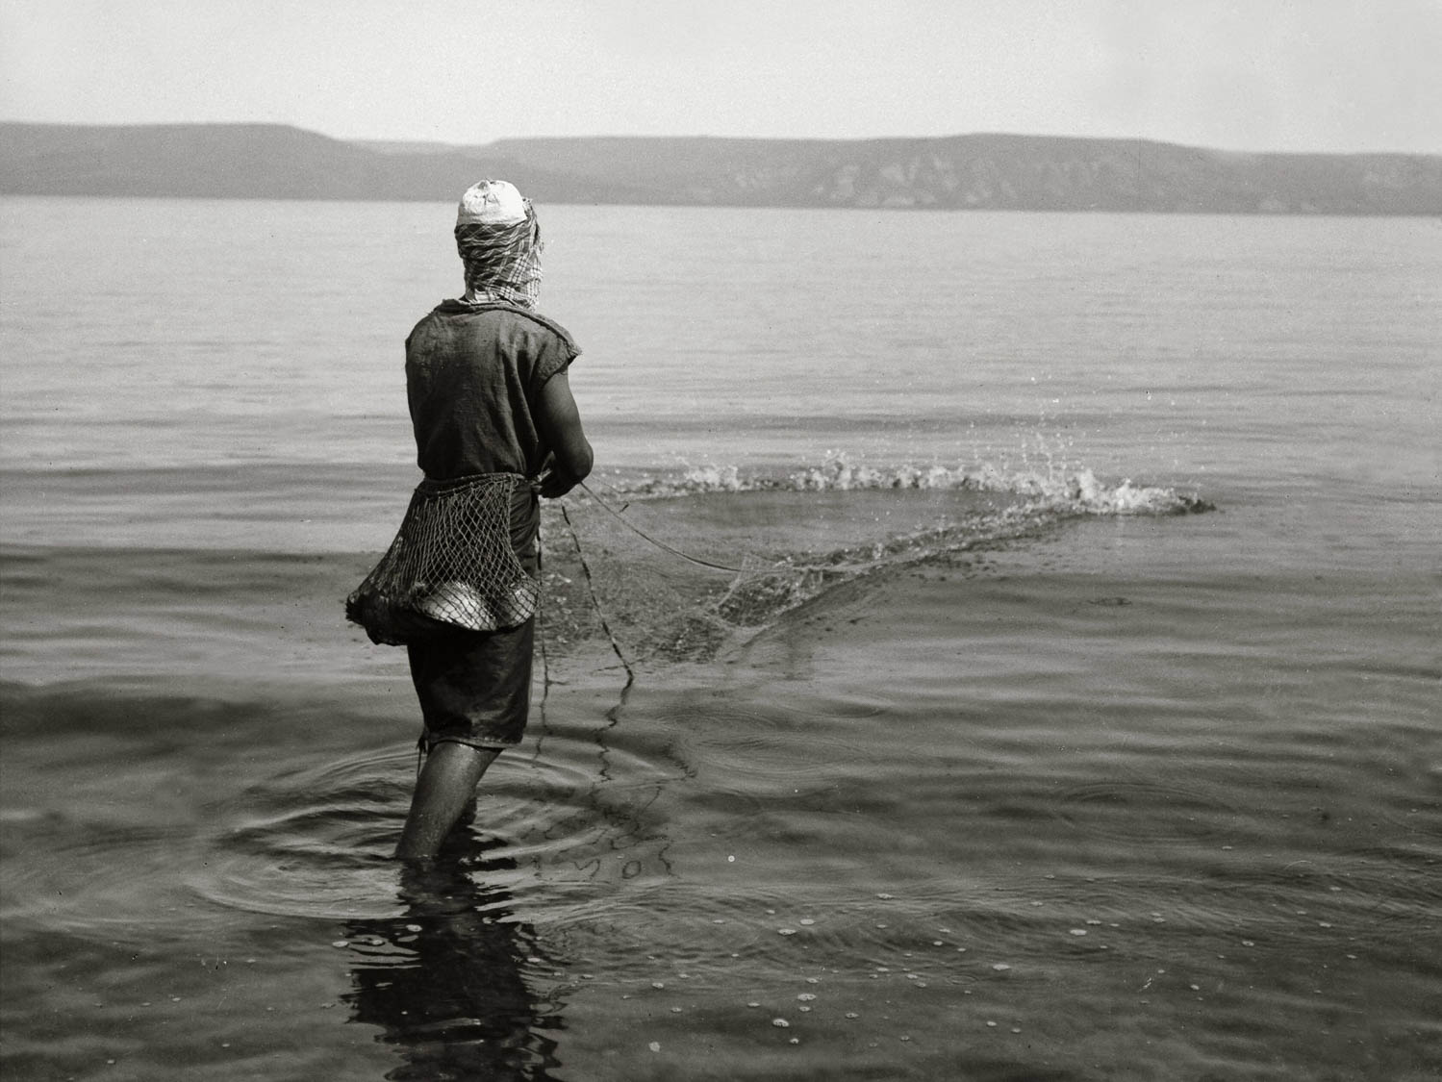
Fisherman casting his net
Fisherman casting his net
Notes:
“At el Huleh and the ‘Ain el Mellahah stream (which flows into this Lake) fishing is carried on by very primitive methods. The Bedawin fishermen occupy a mat hut, made of papyrus, on the western shore, close to the Jewish settlement of Izbaid. During the day they catch fish by means of the ‘cast-net,’ as will be described; but at night they employ boats and use the m’batten” (Masterman 1908: 42).
“The casting-net.—When using this, the fisherman stands on the bank or wades breast-deep into the water, and skilfully throws the net which he had arranged on his arm into the water in front of him. It falls in the shape of a ring, and as the lead weights around the fringe drag it down, the net takes the shape of a dome or cone in sinking, and finally falls upon the fishes it encloses. The fisherman then dives down and draws the leads securely together, and carries net and fish to the bank. Favourite spots are the warm springs above Magdala, where the fish congregate in vast swarms, and the fisherman frequently flings in some bait to bring them to one spot, and near enough to the shore for his purpose” (Mackie 1898: 75).
Date of photograph: between 1900 and 1920
mat00691

Slide 19
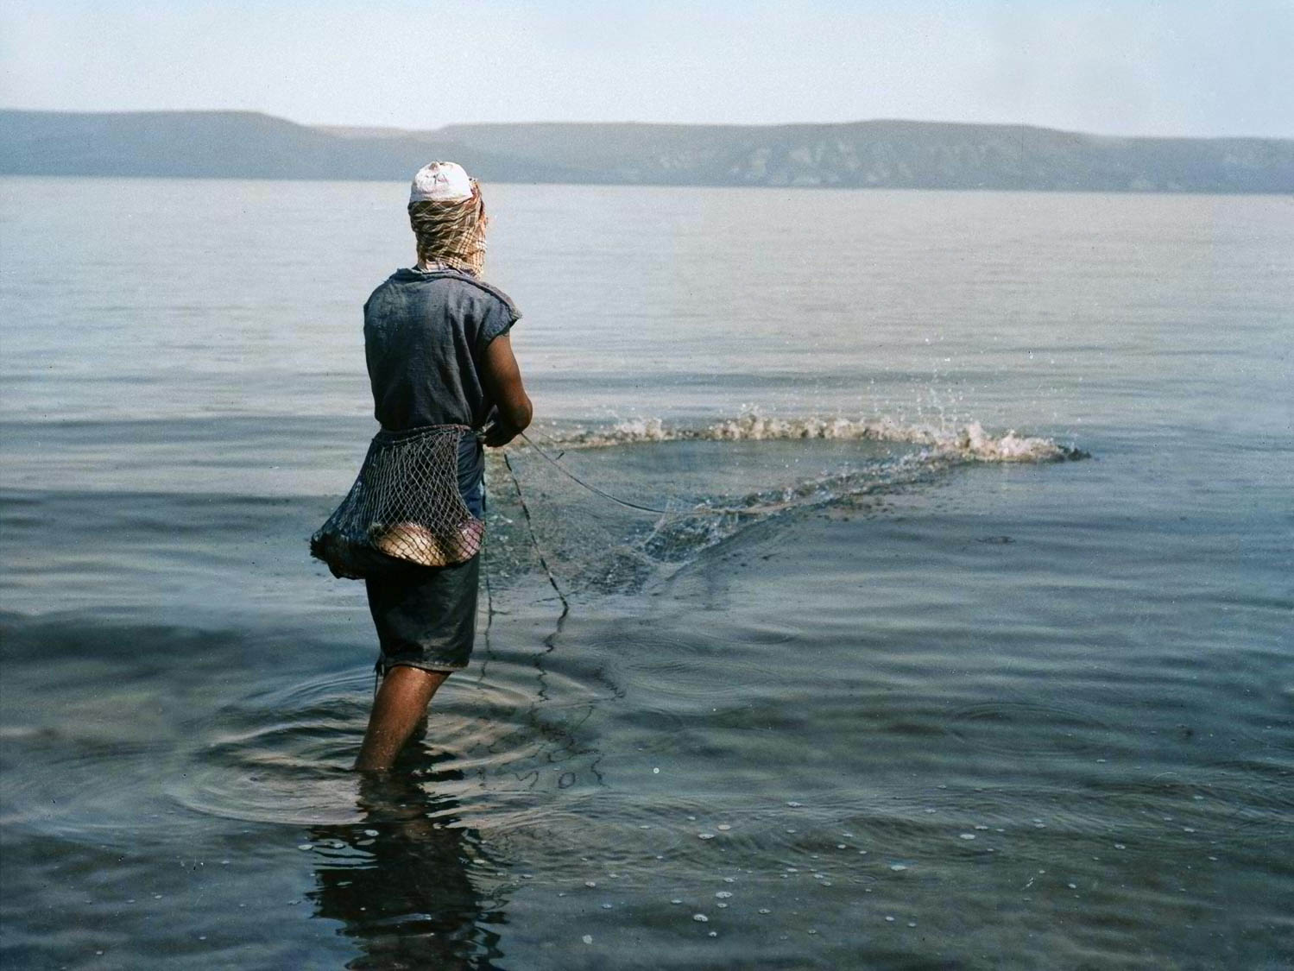
Fisherman casting his net
Fisherman casting his net
Notes:
“At el Huleh and the ‘Ain el Mellahah stream (which flows into this Lake) fishing is carried on by very primitive methods. The Bedawin fishermen occupy a mat hut, made of papyrus, on the western shore, close to the Jewish settlement of Izbaid. During the day they catch fish by means of the ‘cast-net,’ as will be described; but at night they employ boats and use the m’batten” (Masterman 1908: 42).
“The casting-net.—When using this, the fisherman stands on the bank or wades breast-deep into the water, and skilfully throws the net which he had arranged on his arm into the water in front of him. It falls in the shape of a ring, and as the lead weights around the fringe drag it down, the net takes the shape of a dome or cone in sinking, and finally falls upon the fishes it encloses. The fisherman then dives down and draws the leads securely together, and carries net and fish to the bank. Favourite spots are the warm springs above Magdala, where the fish congregate in vast swarms, and the fisherman frequently flings in some bait to bring them to one spot, and near enough to the shore for his purpose” (Mackie 1898: 75).
Date of photograph: between 1900 and 1920
mat00691col

Slide 20
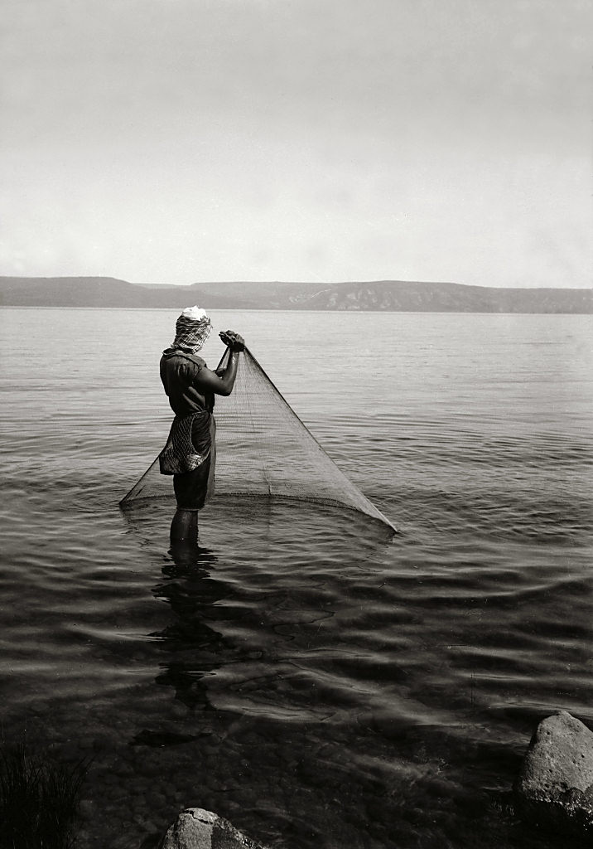
Fisherman with cast net
Fisherman with cast net
Notes:
“Again, there is the bag-net, so constructed as to enclose the fish out in deep water, and is then drawn up into the boat. It was with one of this kind, I suppose, that Simon Peter had toiled all night without catching anything, but which, when let down at the command of Jesus, ‘inclosed a great multitude of fishes, and their net brake, and they filled both the ships, so that they began to sink’” (Thomson 1882: 349).
“Here in this hot climate, however, it is common, when fishing, to have only a mahzân, or towel, round the waist. The fisher’s coat which he girt about him was probably the short ’abâyeh now worn, and which is often laid aside. Open in front, it can be doffed and donned in a moment. When worn, it is girt about the loins with the zunâr, or girdle; and Peter did this when hastening to meet the Lord” (Thomson 1882: 349).
Location of photograph: Sea of Galilee
Date of photograph: between 1900 and 1920
mat05156

Slide 21
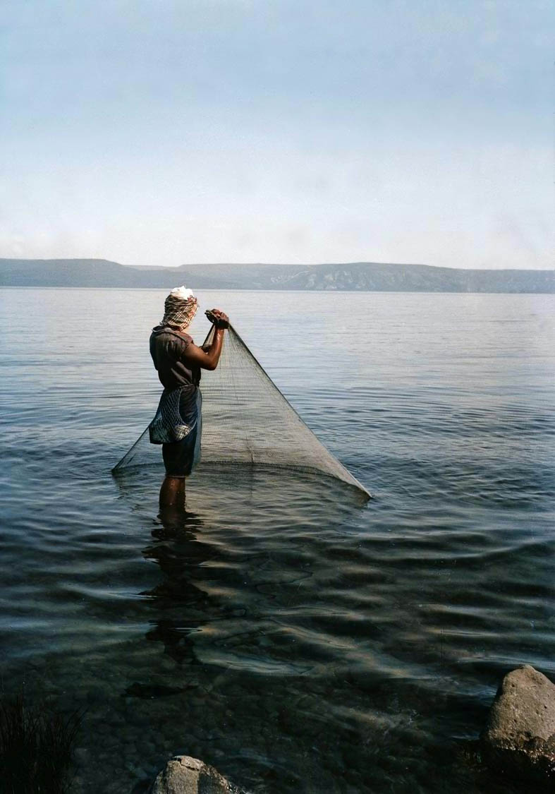
Fisherman with cast net
Fisherman with cast net
Notes:
“Again, there is the bag-net, so constructed as to enclose the fish out in deep water, and is then drawn up into the boat. It was with one of this kind, I suppose, that Simon Peter had toiled all night without catching anything, but which, when let down at the command of Jesus, ‘inclosed a great multitude of fishes, and their net brake, and they filled both the ships, so that they began to sink’” (Thomson 1882: 349).
“Here in this hot climate, however, it is common, when fishing, to have only a mahzân, or towel, round the waist. The fisher’s coat which he girt about him was probably the short ’abâyeh now worn, and which is often laid aside. Open in front, it can be doffed and donned in a moment. When worn, it is girt about the loins with the zunâr, or girdle; and Peter did this when hastening to meet the Lord” (Thomson 1882: 349).
Location of photograph: Sea of Galilee
Date of photograph: between 1900 and 1920
mat05156col

Slide 22
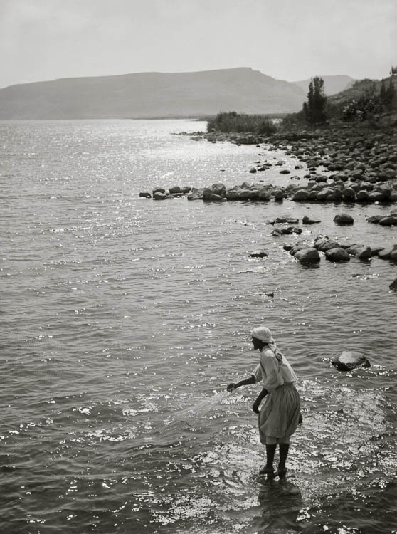
Fisherman casting net at Capernaum
Fisherman casting net at Capernaum
Notes:
“The ‘cast net’ is a small circular net with small bars of lead attached all round its margin: to the centre is usually fixed a small cord. It is apparently the amfiblhstron of Mtt. iv, 18, and Mark i, 18. Three sizes are used, differing in wideness of spread and in fineness of mesh. The smallest size, used for sardinnen, is known as el mukheiyer; the second, the most commonly used, is called esh shbakeh (a name usually applied by the public to all ‘cast nets’) or ‘Ashraneyeh Kafafeh; while the largest, used only in mid-winter for the largest musht, is called ‘Ashraneye Saroseyeh, or simply as saroseyeh” (Masterman 1908: 44).
“The fisherman carefully arranges the net on his right arm, the weight hang free but the net is wound up. As the fine mesh get readily in a tangle he critically examines the weights to see that none are out of place. He then advances into the water up to his waist, having gathered his scanty garments well out of the way; he cautiously looks around till he sees some indication of fish—a few fins showing, a troubled surface, or a fish jumping—and then with a bold swing of his arm he deftly lets his net fly through the air so that it spread out flat and descends into and through the water with its weighted edges in a complete level circle. As it does so, it necessarily shuts in all the fish in the area over which it falls. The fisherman knows the lie of the net by means of the cord in his hand. He then walks over the net, feeling with his feet the nature of its content, and flattening it down in his progress so that the fish become well entangled in its meshes. He now draws it up again by means of the centre cord, and as he carefully twists it up over his arm he disentangles the captives one by one. He may in this way capture several dozen fish in one throw, indeed (specially when the net is used in conjunction with the jarf, as described below), so great may be the mass of fish that the net cannot be raised but must be dragged to the shore. It is seldom that the skilled man casts with no result whatever” (Masterman 1908: 44-45).
Date of photograph: between 1898 and 1946
mat05938

Slide 23
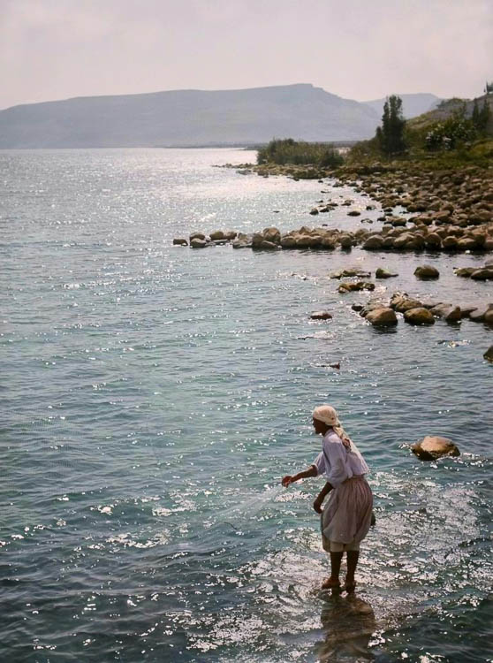
Fisherman casting net at Capernaum
Fisherman casting net at Capernaum
Notes:
“The ‘cast net’ is a small circular net with small bars of lead attached all round its margin: to the centre is usually fixed a small cord. It is apparently the amfiblhstron of Mtt. iv, 18, and Mark i, 18. Three sizes are used, differing in wideness of spread and in fineness of mesh. The smallest size, used for sardinnen, is known as el mukheiyer; the second, the most commonly used, is called esh shbakeh (a name usually applied by the public to all ‘cast nets’) or ‘Ashraneyeh Kafafeh; while the largest, used only in mid-winter for the largest musht, is called ‘Ashraneye Saroseyeh, or simply as saroseyeh” (Masterman 1908: 44).
“The fisherman carefully arranges the net on his right arm, the weight hang free but the net is wound up. As the fine mesh get readily in a tangle he critically examines the weights to see that none are out of place. He then advances into the water up to his waist, having gathered his scanty garments well out of the way; he cautiously looks around till he sees some indication of fish—a few fins showing, a troubled surface, or a fish jumping—and then with a bold swing of his arm he deftly lets his net fly through the air so that it spread out flat and descends into and through the water with its weighted edges in a complete level circle. As it does so, it necessarily shuts in all the fish in the area over which it falls. The fisherman knows the lie of the net by means of the cord in his hand. He then walks over the net, feeling with his feet the nature of its content, and flattening it down in his progress so that the fish become well entangled in its meshes. He now draws it up again by means of the centre cord, and as he carefully twists it up over his arm he disentangles the captives one by one. He may in this way capture several dozen fish in one throw, indeed (specially when the net is used in conjunction with the jarf, as described below), so great may be the mass of fish that the net cannot be raised but must be dragged to the shore. It is seldom that the skilled man casts with no result whatever” (Masterman 1908: 44-45).
Date of photograph: between 1898 and 1946
mat05938col

Slide 24
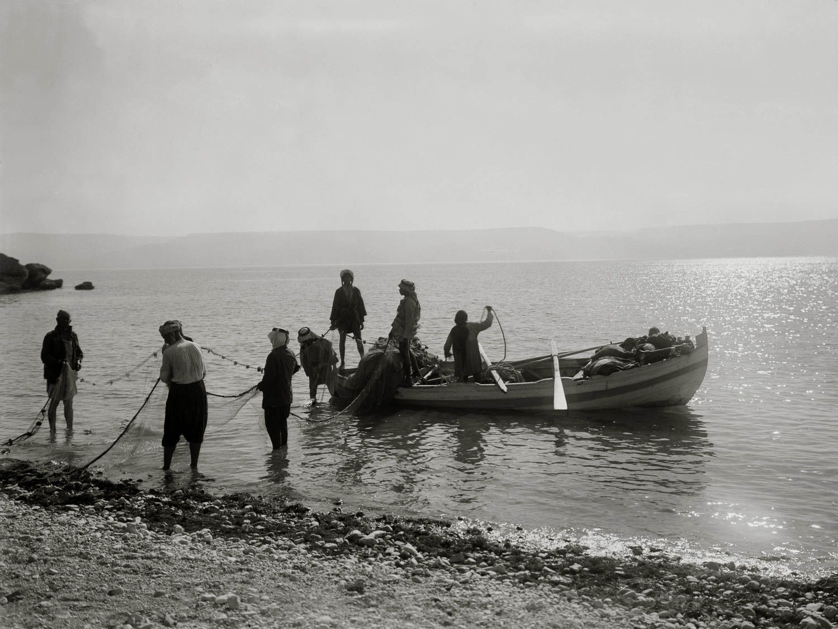
Fishermen letting down nets
Fishermen letting down nets
Notes:
“The m’batten can be laid in any depth of water as it does not touch the bottom, but as a matter of experience, the fishermen find that the biggest hauls are made usually not far from the shore. The net is paid out in a long line parallel to the shore, the fishermen then row their boats slowly along its whole length and back again—particularly on the landward side—in order to frighten the fishes. If there is a large catch, the net weighed down with its contents, sinks in the middle. When this happens it is immediately hauled on board the two boats. If there is no such result, the net may be left out from the middle of the night till daybreak. Before paying out the nets, the fishermen are often able, even in the darkest nights, to locate a shoal of fish by the sound of the fishes opening and shutting their mouths at the surface” (Masterman 1908: 46).
Location of photograph: Sea of Galilee
Date of photograph: between 1900 and 1920
mat05686

Slide 25
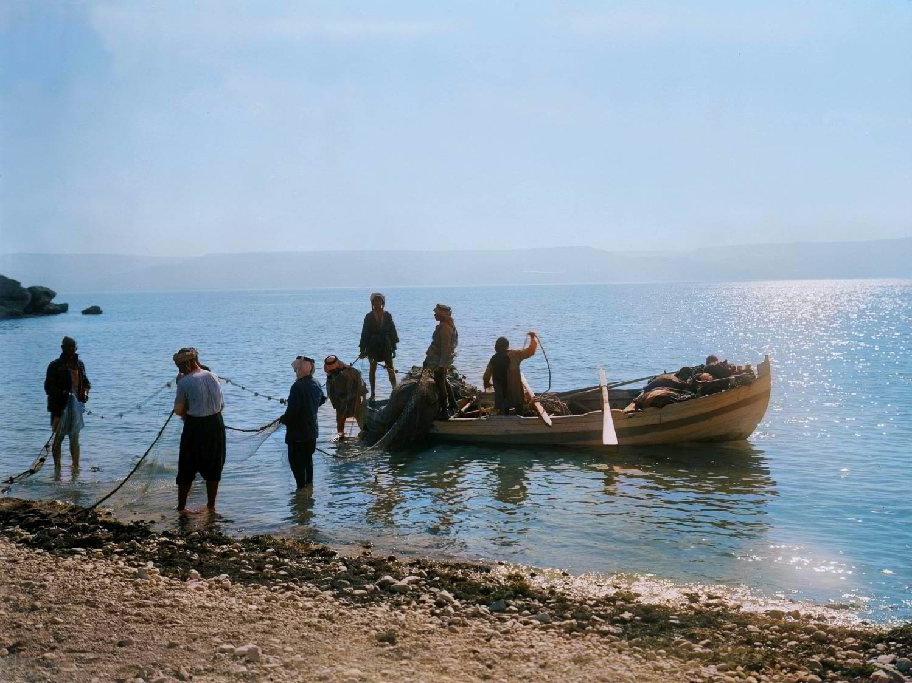
Fishermen letting down nets
Fishermen letting down nets
Notes:
“The m’batten can be laid in any depth of water as it does not touch the bottom, but as a matter of experience, the fishermen find that the biggest hauls are made usually not far from the shore. The net is paid out in a long line parallel to the shore, the fishermen then row their boats slowly along its whole length and back again—particularly on the landward side—in order to frighten the fishes. If there is a large catch, the net weighed down with its contents, sinks in the middle. When this happens it is immediately hauled on board the two boats. If there is no such result, the net may be left out from the middle of the night till daybreak. Before paying out the nets, the fishermen are often able, even in the darkest nights, to locate a shoal of fish by the sound of the fishes opening and shutting their mouths at the surface” (Masterman 1908: 46).
Location of photograph: Sea of Galilee
Date of photograph: between 1900 and 1920
mat05686col

Slide 26
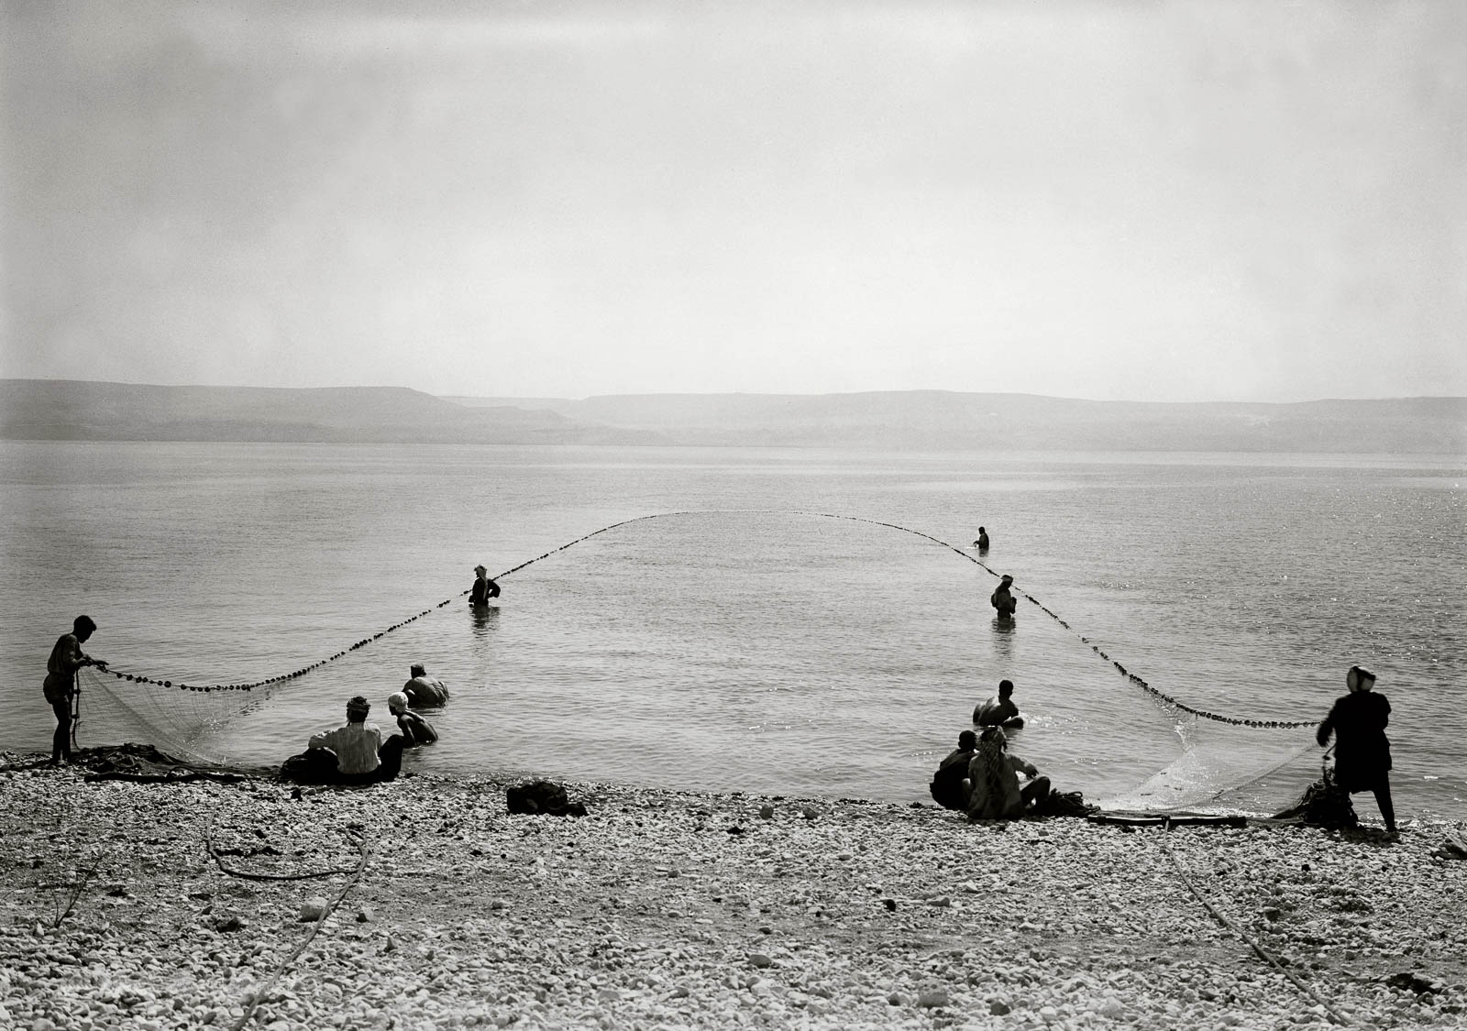
Fishermen drawing in dragnet
Fishermen drawing in dragnet
Notes:
“The drag net is of the same open form as is used in herring and salmon fishing, with floats along the top and leads along the bottom of the net. It is worked from boats by forming a loop, and thus enclosing the fish” (Mackie 1898: 75).
Location of photograph: Sea of Galilee
Date of photograph: between 1940 and 1946
mat04570

Slide 27
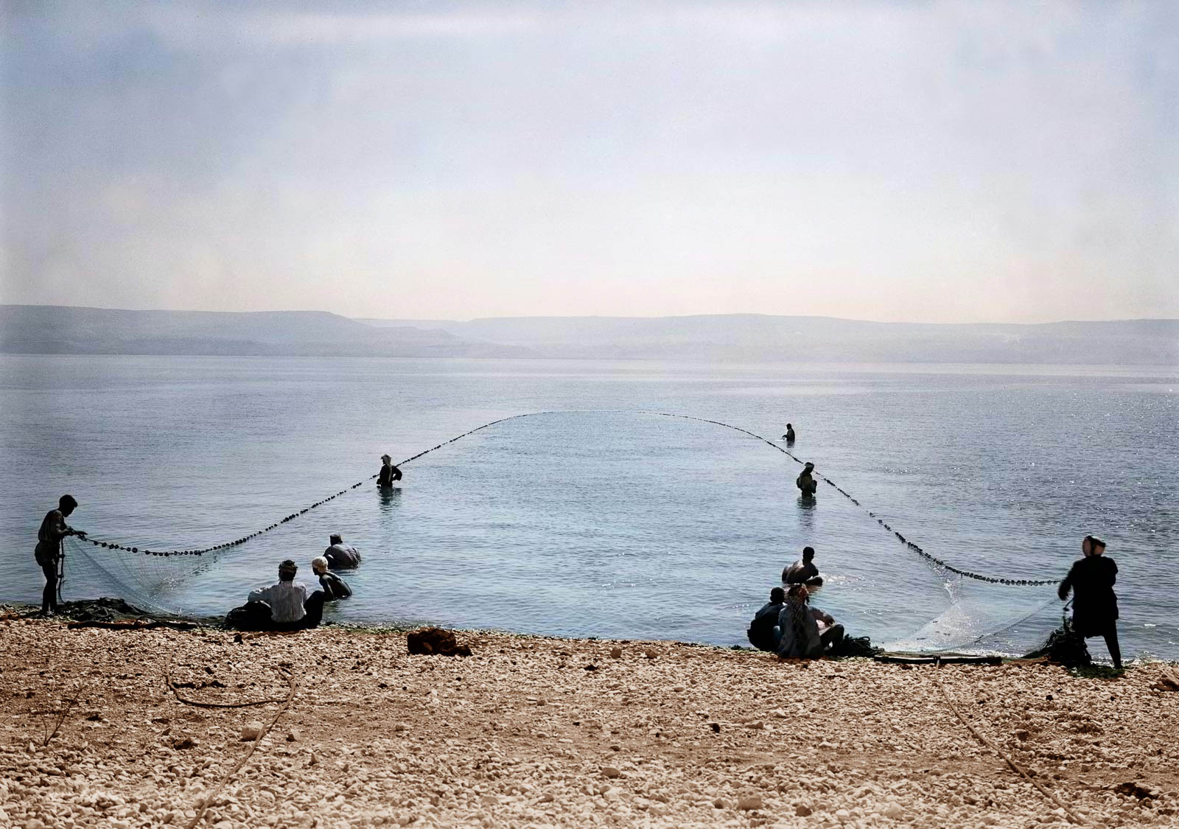
Fishermen drawing in dragnet
Fishermen drawing in dragnet
Notes:
“The drag net is of the same open form as is used in herring and salmon fishing, with floats along the top and leads along the bottom of the net. It is worked from boats by forming a loop, and thus enclosing the fish” (Mackie 1898: 75).
Location of photograph: Sea of Galilee
Date of photograph: between 1940 and 1946
mat04570col

Slide 28
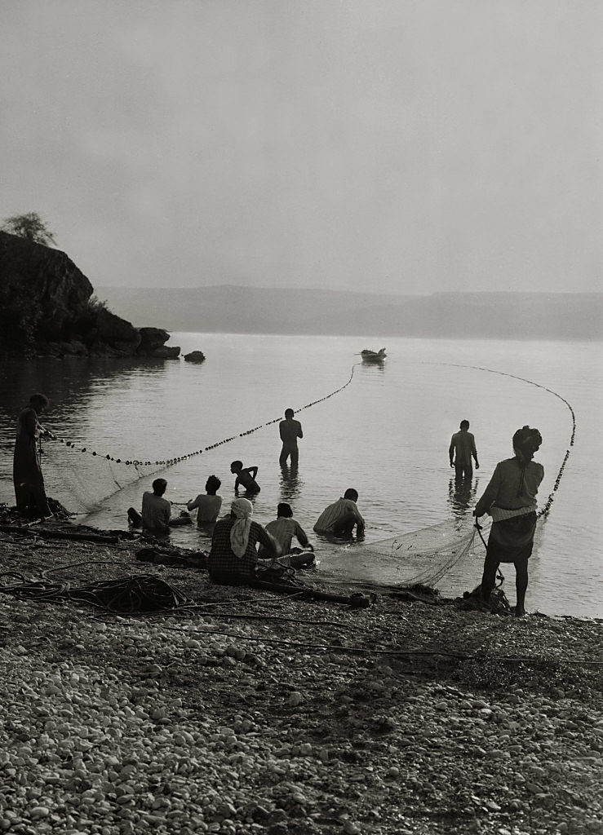
Fishermen drawing in dragnet
Fishermen drawing in dragnet
Notes:
“Then there is the great drag-net, the working of which teaches the value of united effort. Some must row the boat, some cast out the net; some on the shore pull the rope with all their strength; others throw stones and beat the water, to prevent the fish from escaping; and as it approaches the shore, every one is active in holding up the edges, drawing it to land, and seizing the fish. This is that new which gathers ‘of every kind,’ and, when drawn to the shore, the fishermen sit down and collect ‘the good into vessels, but cast the bad away.’ I have watched this operation throughout a hundred times along the shore of the Mediterranean” (Thomson 1882: 348).
Date of photograph: between 1900 and 1920
mat05687

Slide 29
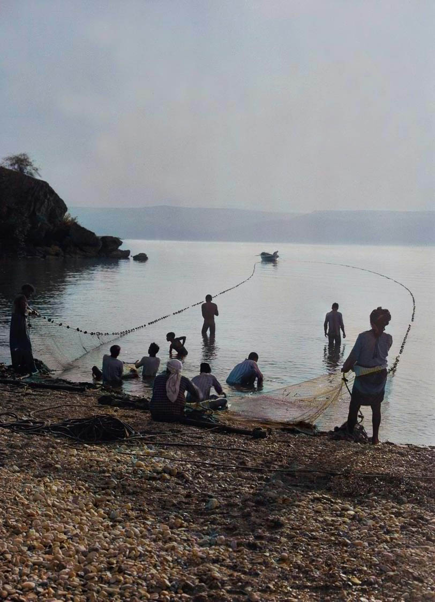
Fishermen drawing in dragnet
Fishermen drawing in dragnet
Notes:
“Then there is the great drag-net, the working of which teaches the value of united effort. Some must row the boat, some cast out the net; some on the shore pull the rope with all their strength; others throw stones and beat the water, to prevent the fish from escaping; and as it approaches the shore, every one is active in holding up the edges, drawing it to land, and seizing the fish. This is that new which gathers ‘of every kind,’ and, when drawn to the shore, the fishermen sit down and collect ‘the good into vessels, but cast the bad away.’ I have watched this operation throughout a hundred times along the shore of the Mediterranean” (Thomson 1882: 348).
Date of photograph: between 1900 and 1920
mat05687col

Slide 30
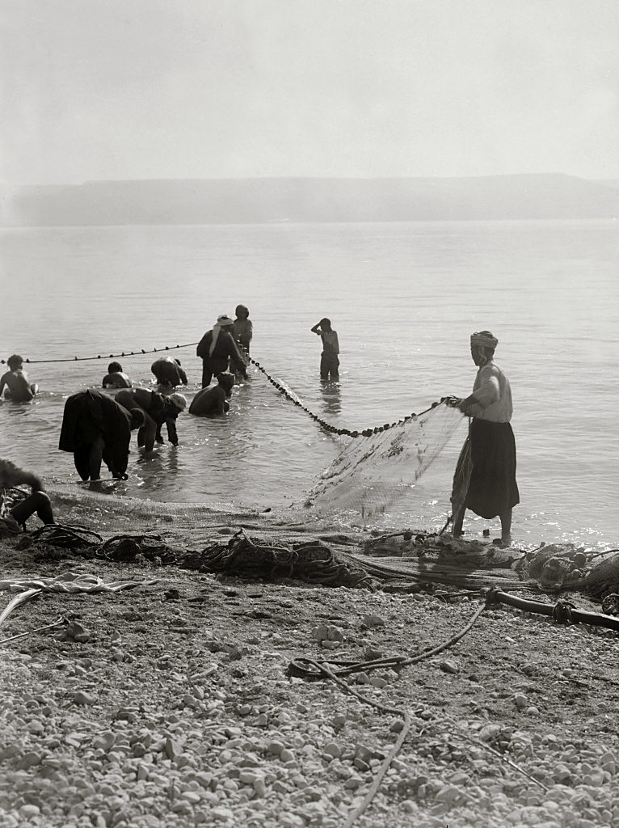
Fishermen drawing in dragnet
Fishermen drawing in dragnet
Notes:
“The jarf or ‘drag net’ is as much as 400 metres long. In mesh it is as fine as the shabakeh. It is used at the Lake chiefly during daylight, but along the Bay of Acre many of these nets are employed after the sunset with lanterns and torches to illuminate the scene. The net is paid out of a boat in an immense semicircle, the two ends being near the shore. The upper side floats by means of corks, the lower is kept down by small lead weights. As soon as the net is in position the men on the shore commence the process of hauling it in. Four men, if possible, take charge of each extremity, they have long ropes fixed to the lower and upper corners so that they drag in the bottom at the same time as the top. In order that a steady and uninterrupted pull may be kept up they merely fix the ropes to their belts, and each man nearest the landward end of the ropes, as soon as there is room, leaves off his hold there and runs forward to seize the ropes at the net-end as they come in shore. The fishermen consider it a matter of importance that when once the net has commenced to come in, there should be no pause in its progress. As the centre parts begin to come into shallow water some of the fishermen assist its progress by jumping or diving into the water and lifting the weighted lower side over the large stones. This is particularly necessary at Tiberias, where there are many large stones all over the bottom. Finally the net reaches the shore, having ‘gathered of every kind’ (Matt. xiii, 48). Clearly the net (σαγήνη) here described was the draw net” (Masterman 1908: 45).
Location of photograph: Sea of Galilee
Date of photograph: between 1900 and 1920
mat05649

Slide 31
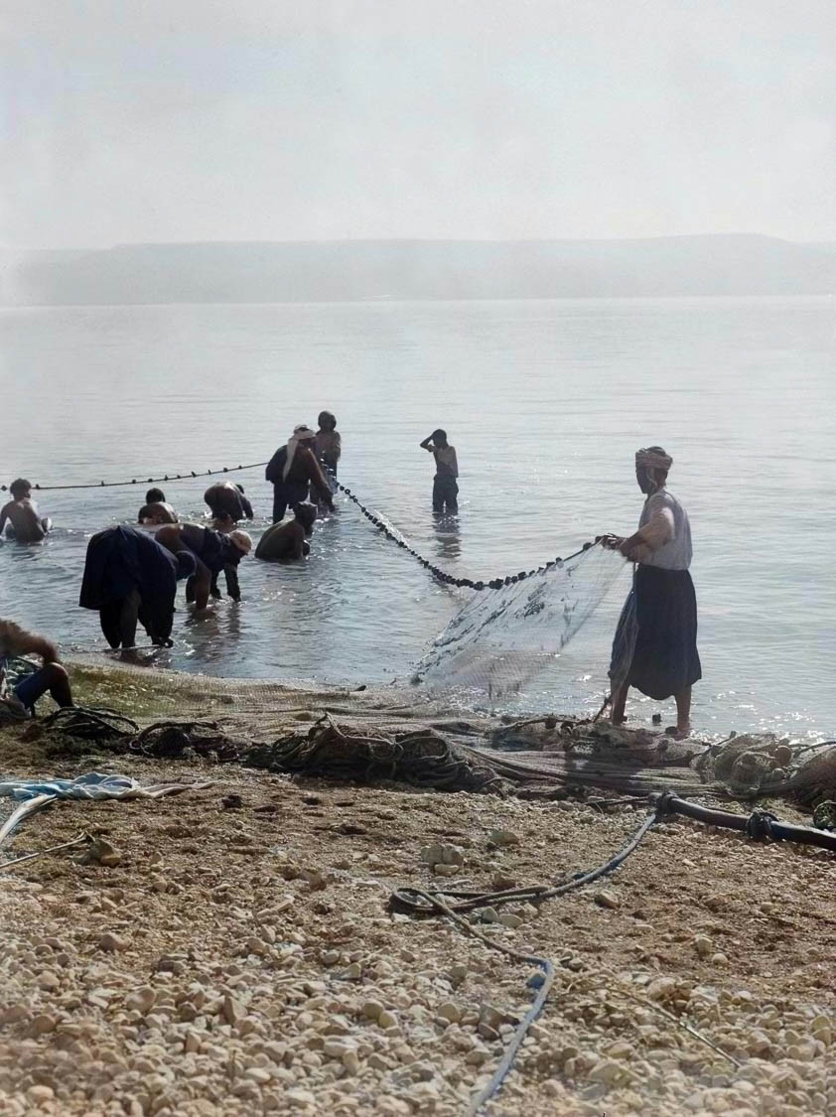
Fishermen drawing in dragnet
Fishermen drawing in dragnet
Notes:
“The jarf or ‘drag net’ is as much as 400 metres long. In mesh it is as fine as the shabakeh. It is used at the Lake chiefly during daylight, but along the Bay of Acre many of these nets are employed after the sunset with lanterns and torches to illuminate the scene. The net is paid out of a boat in an immense semicircle, the two ends being near the shore. The upper side floats by means of corks, the lower is kept down by small lead weights. As soon as the net is in position the men on the shore commence the process of hauling it in. Four men, if possible, take charge of each extremity, they have long ropes fixed to the lower and upper corners so that they drag in the bottom at the same time as the top. In order that a steady and uninterrupted pull may be kept up they merely fix the ropes to their belts, and each man nearest the landward end of the ropes, as soon as there is room, leaves off his hold there and runs forward to seize the ropes at the net-end as they come in shore. The fishermen consider it a matter of importance that when once the net has commenced to come in, there should be no pause in its progress. As the centre parts begin to come into shallow water some of the fishermen assist its progress by jumping or diving into the water and lifting the weighted lower side over the large stones. This is particularly necessary at Tiberias, where there are many large stones all over the bottom. Finally the net reaches the shore, having ‘gathered of every kind’ (Matt. xiii, 48). Clearly the net (σαγήνη) here described was the draw net” (Masterman 1908: 45).
Location of photograph: Sea of Galilee
Date of photograph: between 1900 and 1920
mat05649col

Slide 32
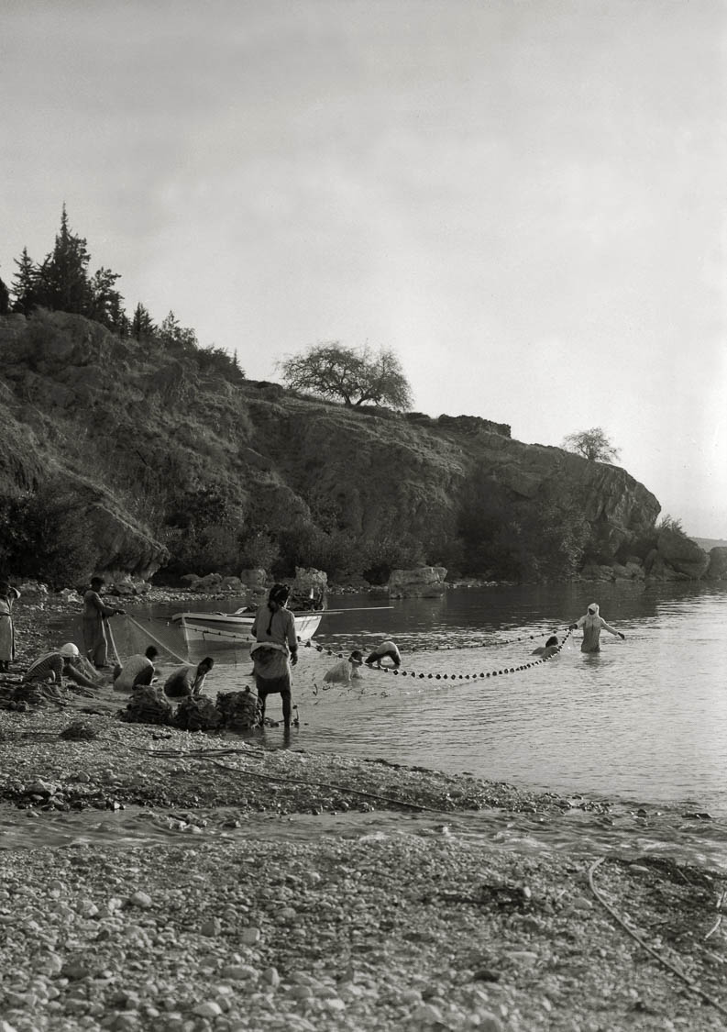
Fishing dragnet almost drawn in
Fishing dragnet almost drawn in
Notes:
Location of photograph: Sea of Galilee
Date of photograph: between 1900 and 1920
mat05688

Slide 33
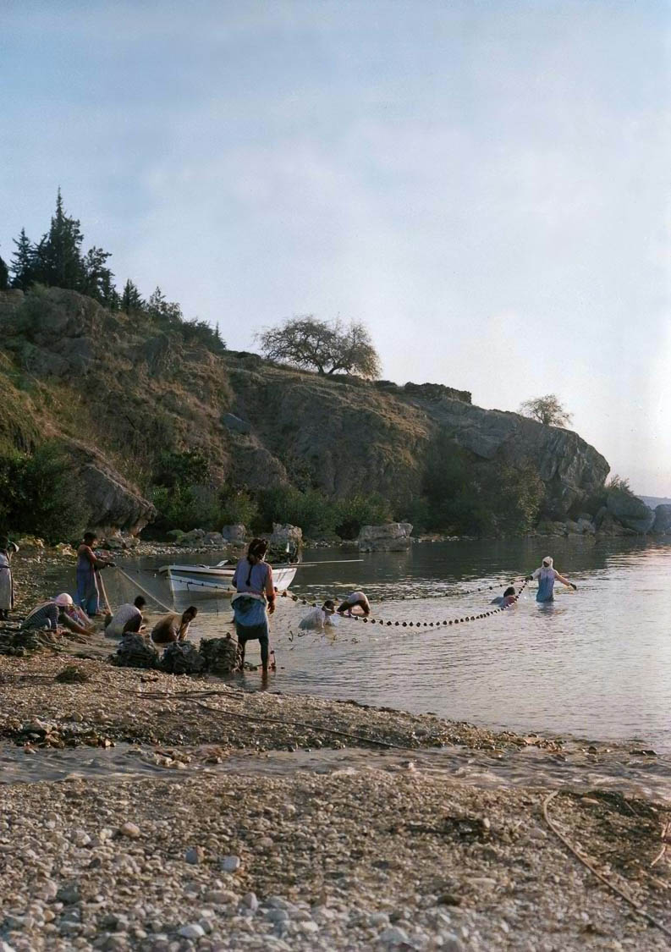
Fishing dragnet almost drawn in
Fishing dragnet almost drawn in
Notes:
Location of photograph: Sea of Galilee
Date of photograph: between 1900 and 1920
mat05688col

Slide 34
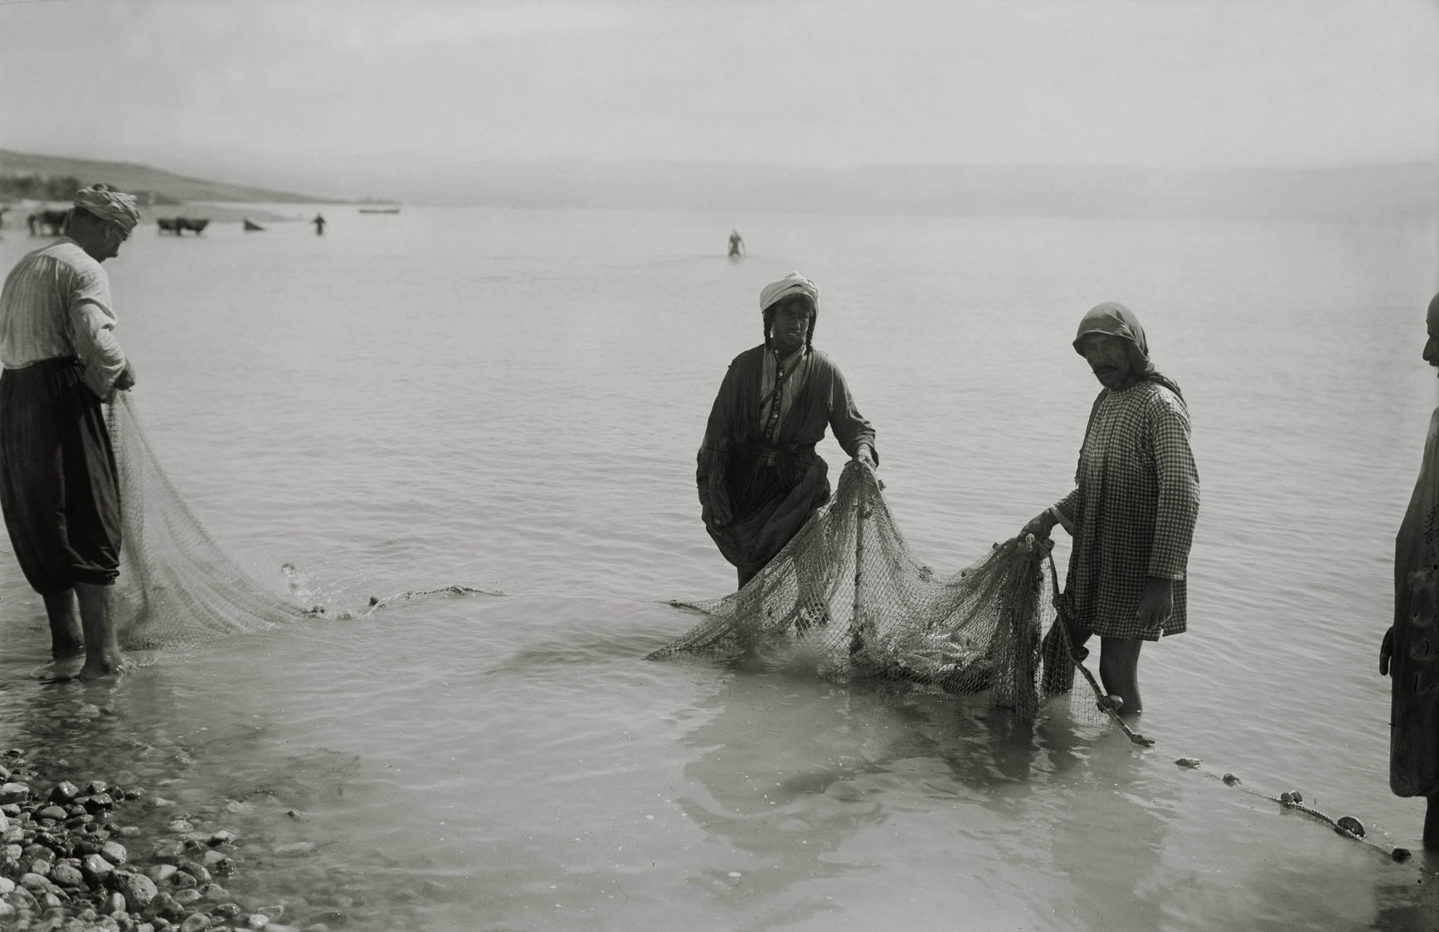
Fishermen with fish in net
Fishermen with fish in net
Notes:
“Almost all the fish are caught by means of nets, of which there three kinds: the ‘cast net’ or shabake, the ‘draw net; or jarf, and the m’batten. The old-fashioned method of poisoning fish is still at times resorted to by amateurs. At Tiberias crumbs of bread mixed with cochineal (which appears to be a fish poison) are thrown on the water, and I am told that even ‘arak (spirits of wine) is also sometimes used. The Arabs at ‘Ain el Mellahah sometimes capture the fish in that pool by means of poison, and they also, when the weather is getting colder, and the fish by instinct make for the deeper waters, stretch nets across the stream and make big hauls. Yet another method employed at times at Tiberias is that of using a weighted string of sharp, unbaited hooks which are rapidly drawn through the water, and, if skill is used, often come up with several impaled victims. This may have been the method referred to in Matt. Xvii, 27. It is, however, the regular fishing with nets which alone is of commercial importance” (Masterman 1908: 43-44).
Location of photograph: Sea of Galilee
Date of photograph: between 1900 and 1920
mat05689

Slide 35
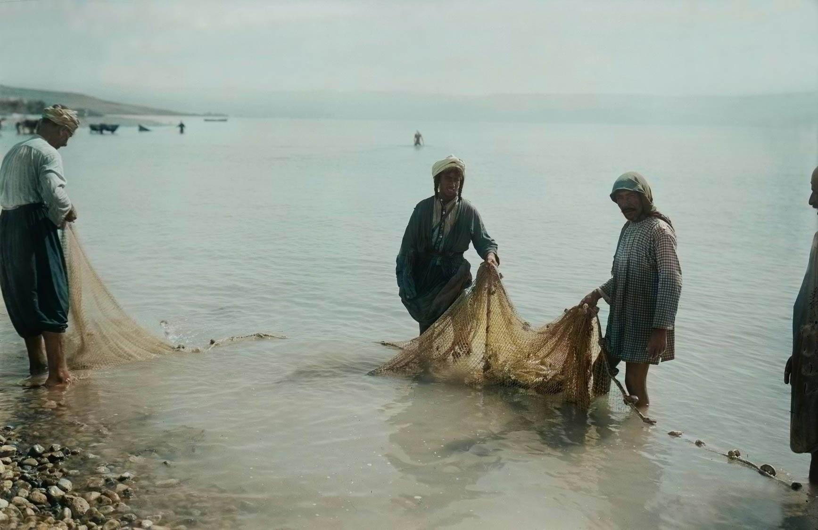
Fishermen with fish in net
Fishermen with fish in net
Notes:
“Almost all the fish are caught by means of nets, of which there three kinds: the ‘cast net’ or shabake, the ‘draw net; or jarf, and the m’batten. The old-fashioned method of poisoning fish is still at times resorted to by amateurs. At Tiberias crumbs of bread mixed with cochineal (which appears to be a fish poison) are thrown on the water, and I am told that even ‘arak (spirits of wine) is also sometimes used. The Arabs at ‘Ain el Mellahah sometimes capture the fish in that pool by means of poison, and they also, when the weather is getting colder, and the fish by instinct make for the deeper waters, stretch nets across the stream and make big hauls. Yet another method employed at times at Tiberias is that of using a weighted string of sharp, unbaited hooks which are rapidly drawn through the water, and, if skill is used, often come up with several impaled victims. This may have been the method referred to in Matt. Xvii, 27. It is, however, the regular fishing with nets which alone is of commercial importance” (Masterman 1908: 43-44).
Location of photograph: Sea of Galilee
Date of photograph: between 1900 and 1920
mat05689col

Slide 36
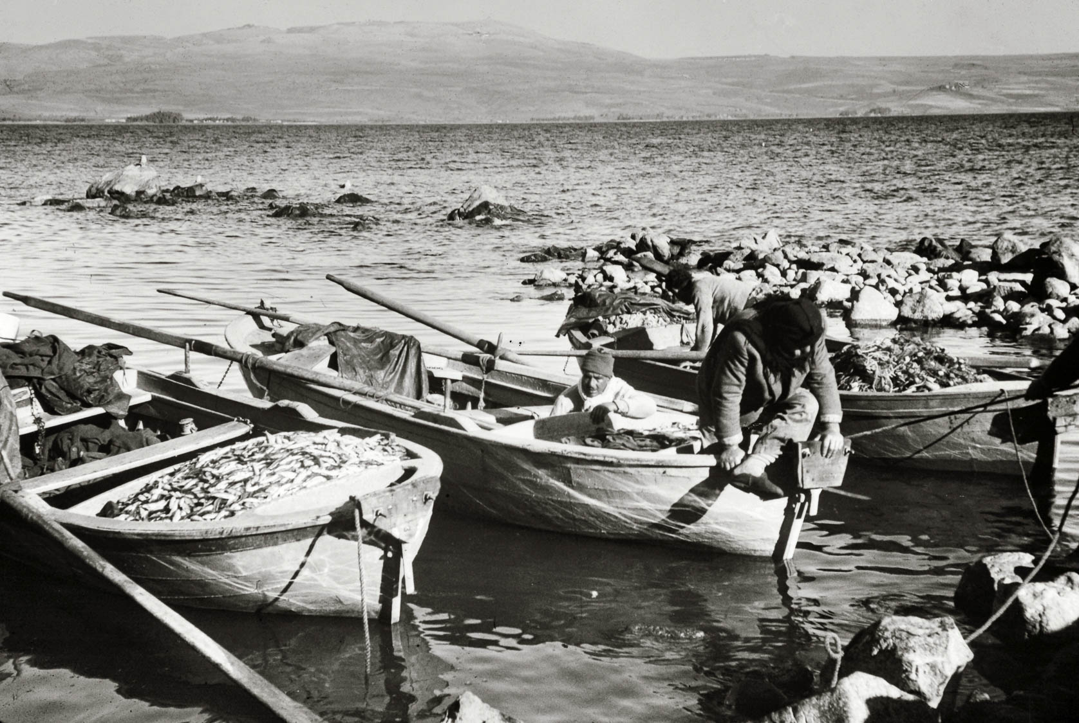
Boats filled with fish
Boats filled with fish
Notes:
“It may well be that they [fish] are even more numerous now than they were in those days [of Jesus], since there are so few fishermen about the lake at present” (Thomson 1882: 392).
Location of photograph: Sea of Galilee
Date of photograph: between 1898 and 1946
mat07411

Slide 37
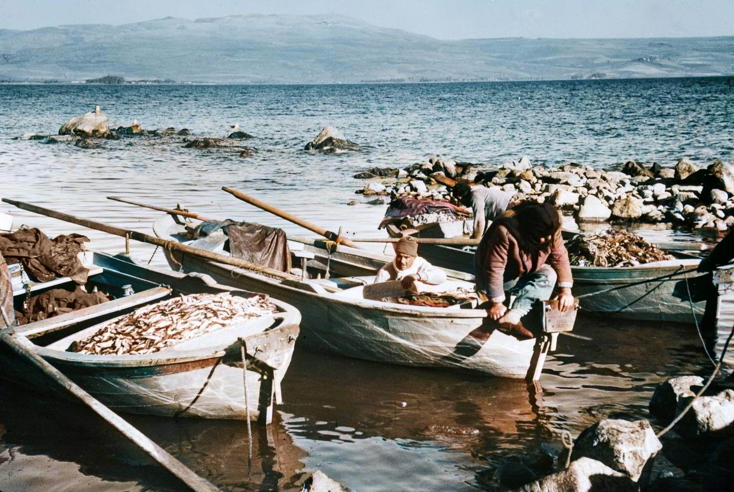
Boats filled with fish
Boats filled with fish
Notes:
“It may well be that they [fish] are even more numerous now than they were in those days [of Jesus], since there are so few fishermen about the lake at present” (Thomson 1882: 392).
Location of photograph: Sea of Galilee
Date of photograph: between 1898 and 1946
mat07411col

Slide 38
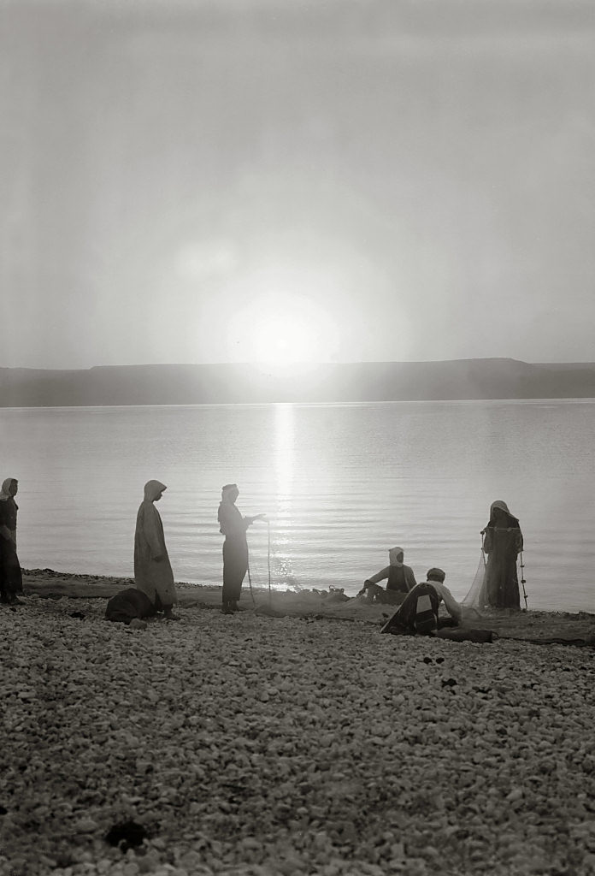
Fishermen mending nets at dawn
Fishermen mending nets at dawn
Notes:
Mark 1:19 (ESV) “And going on a little farther, he saw James the son of Zebedee and John his brother, who were in their boat mending the nets.”
Location of photograph: Sea of Galilee
Date of photograph: between 1940 and 1946
mat04569

Slide 39
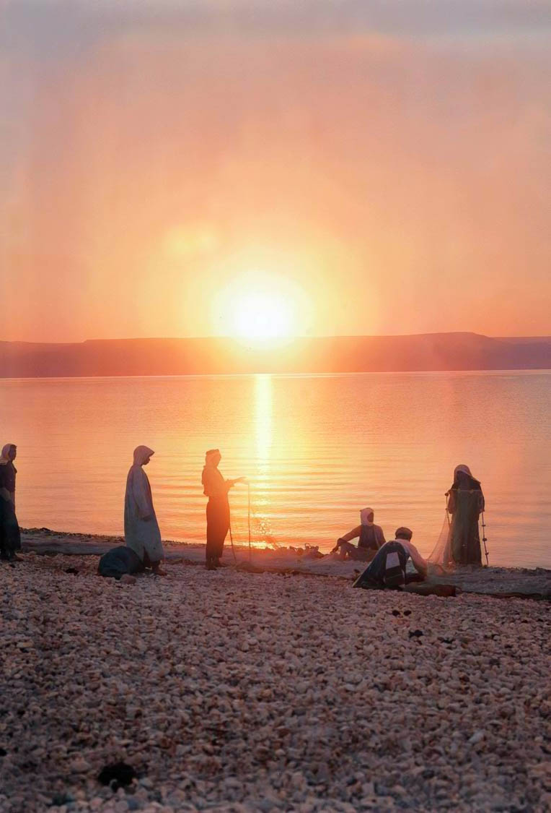
Fishermen mending nets at dawn
Fishermen mending nets at dawn
Notes:
Mark 1:19 (ESV) “And going on a little farther, he saw James the son of Zebedee and John his brother, who were in their boat mending the nets.”
Location of photograph: Sea of Galilee
Date of photograph: between 1940 and 1946
mat04569col

Slide 40
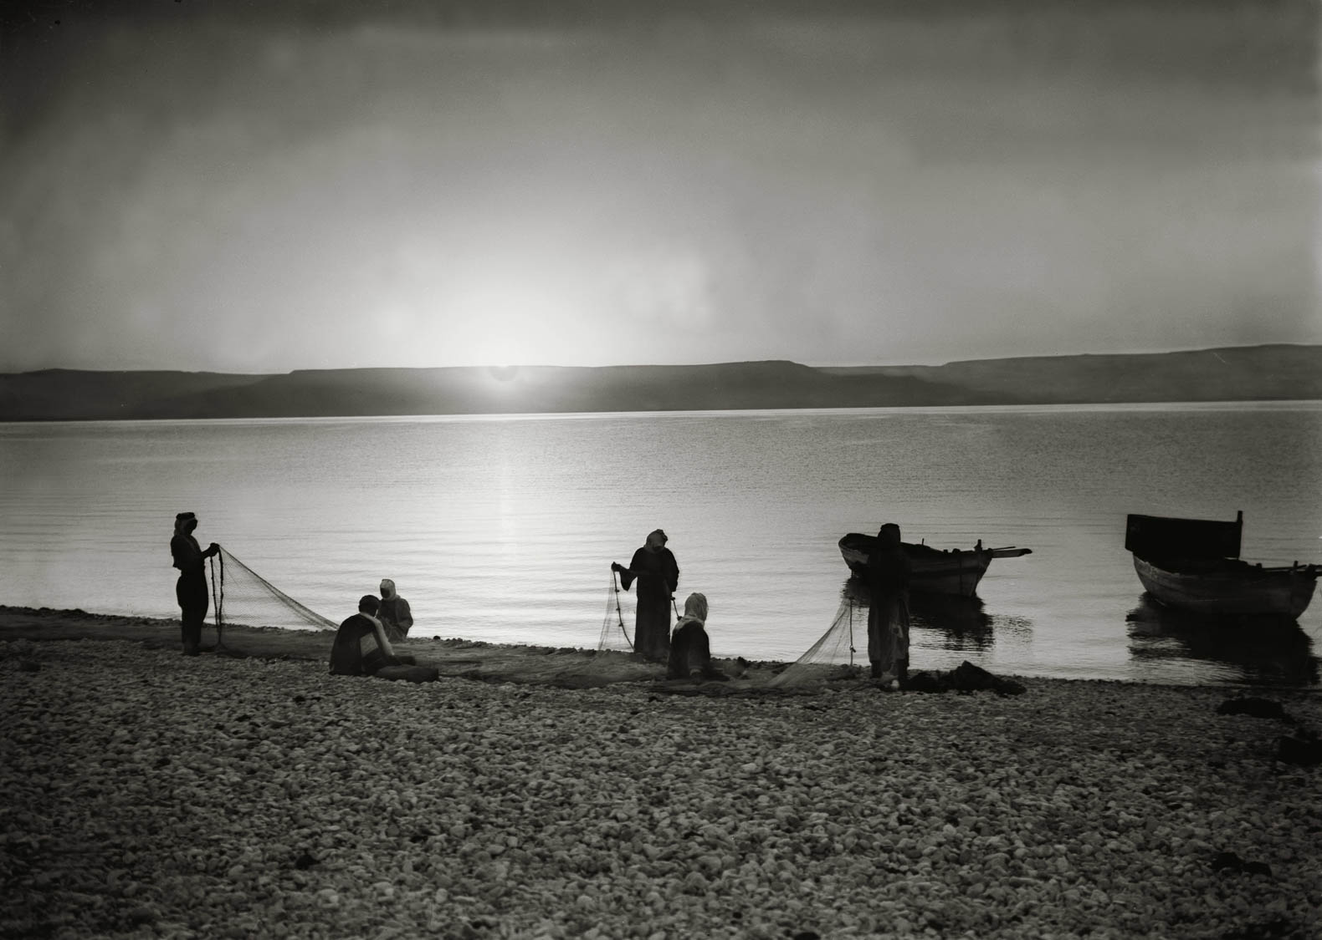
Fishermen mending nets at dawn
Fishermen mending nets at dawn
Notes:
Location of photograph: Sea of Galilee
Date of photograph: between 1900 and 1920
mat05685

Slide 41
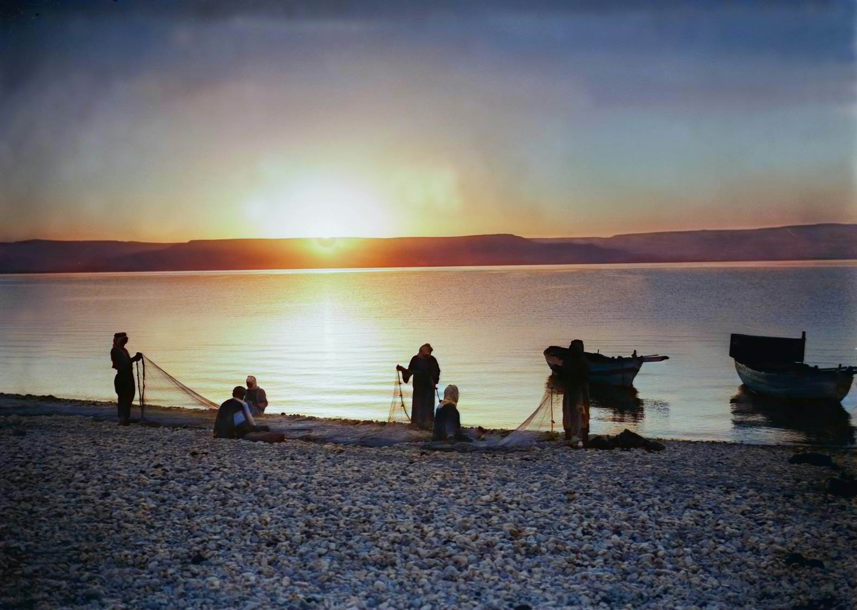
Fishermen mending nets at dawn
Fishermen mending nets at dawn
Notes:
Location of photograph: Sea of Galilee
Date of photograph: between 1900 and 1920
mat05685col

Slide 42
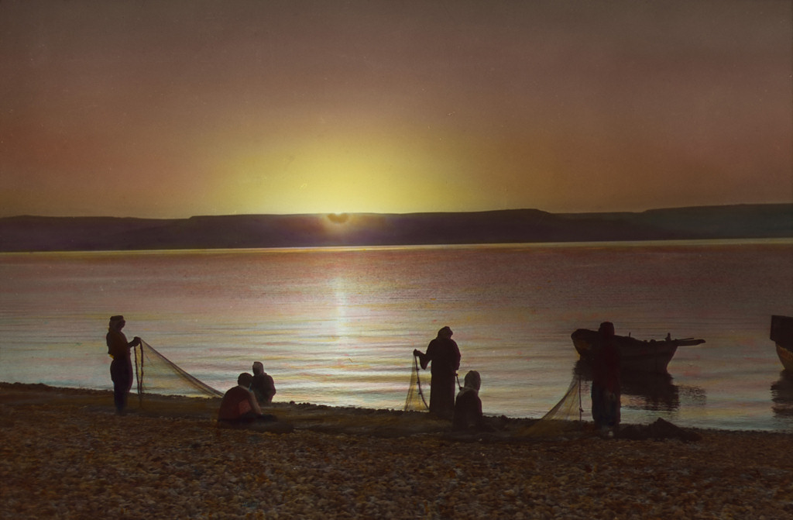
Fishermen mending nets at dawn
Fishermen mending nets at dawn (handcolored)
Notes:
This is one of the photographs that Eric Matson (American Colony) had colorized by hand, probably between 1925 and 1946. It provides a convenient contrast with what AI is capable of doing today.
Date of photograph: between 1900 and 1920
mat14944
42

Slide 43
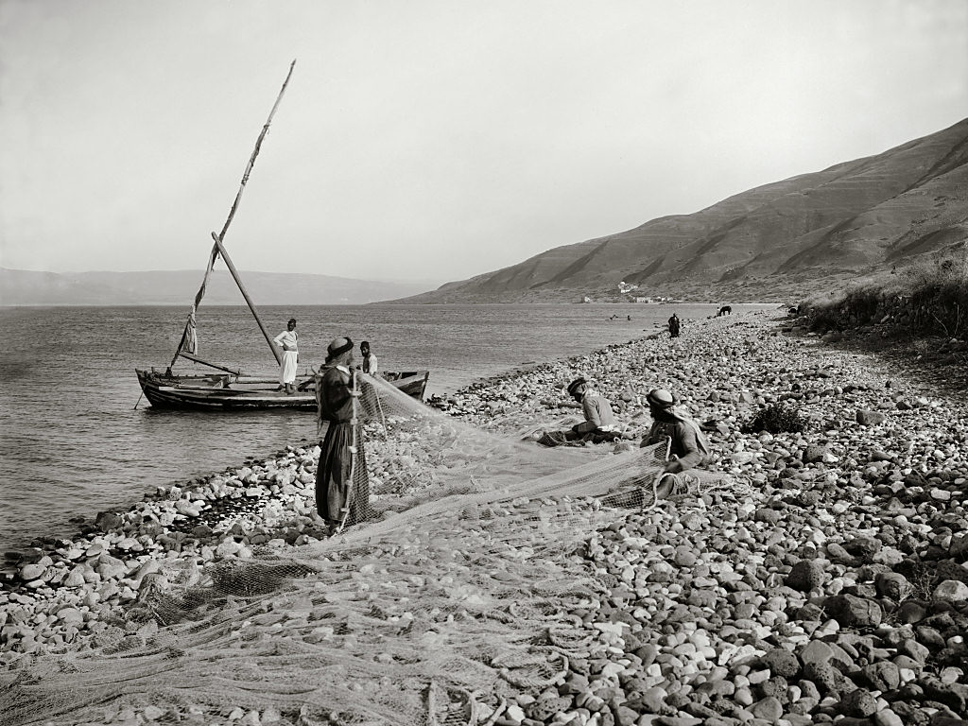
Fishermen mending their nets
Fishermen mending their nets
Notes:
Location of photograph: Sea of Galilee
Date of photograph: between 1898 and 1914
mat07019

Slide 44
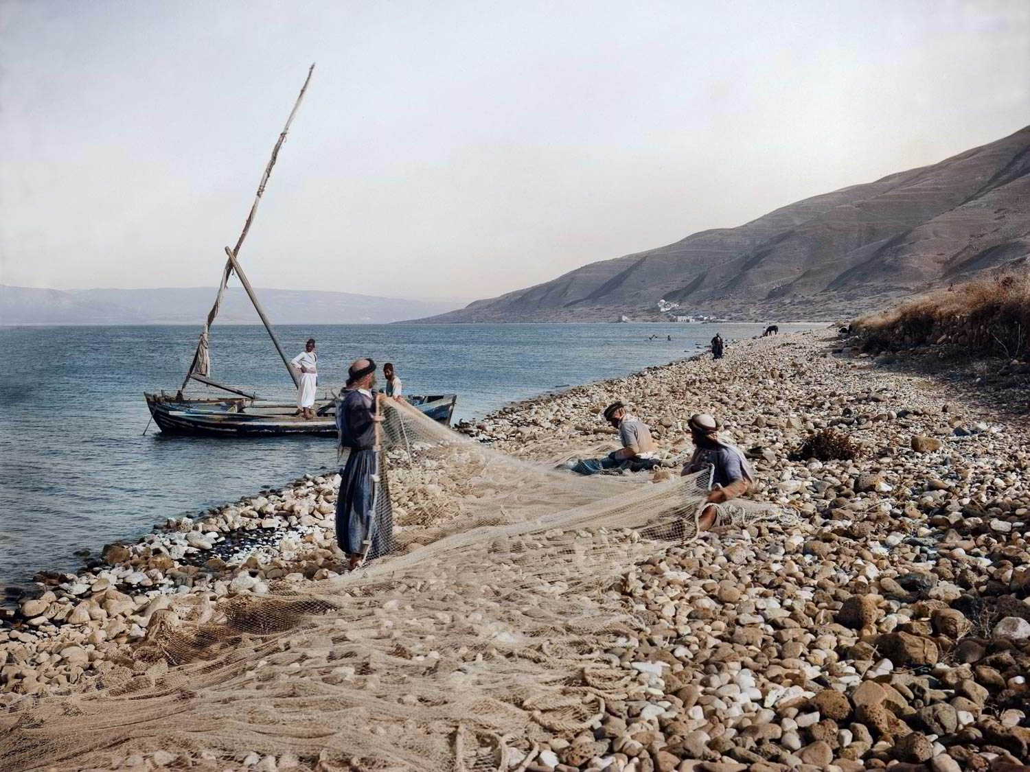
Fishermen mending their nets
Fishermen mending their nets
Notes:
Location of photograph: Sea of Galilee
Date of photograph: between 1898 and 1914
mat07019col

Slide 45
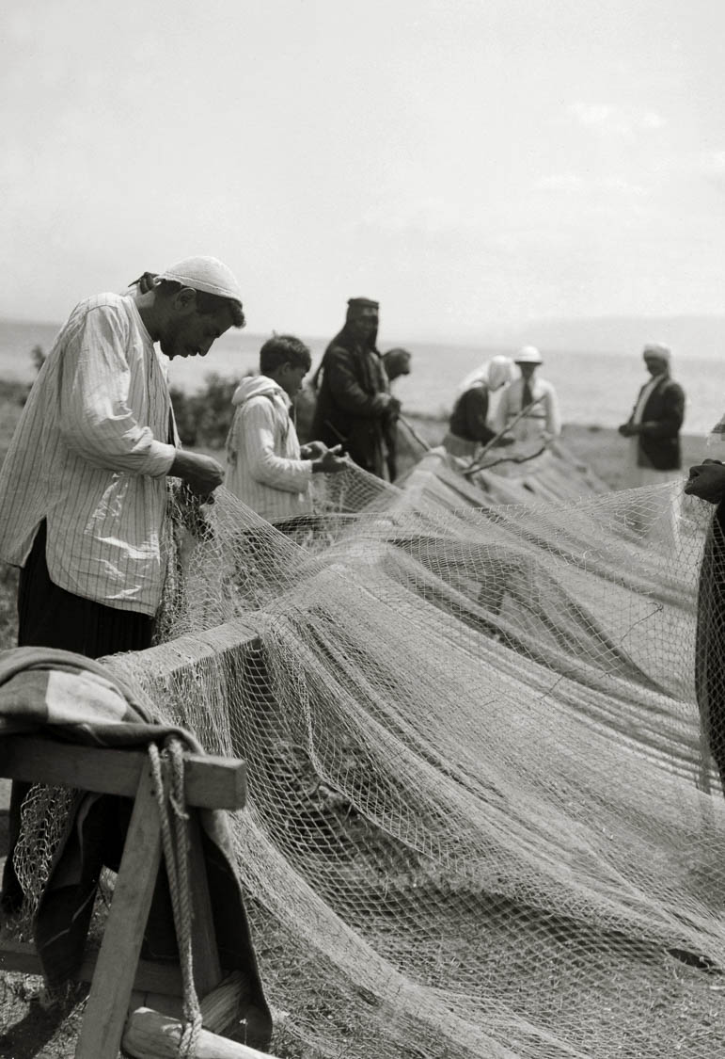
Fishermen mending their nets
Fishermen mending their nets
Notes:
Location of photograph: Sea of Galilee
Date of photograph: between 1934 and 1939
mat04162

Slide 46
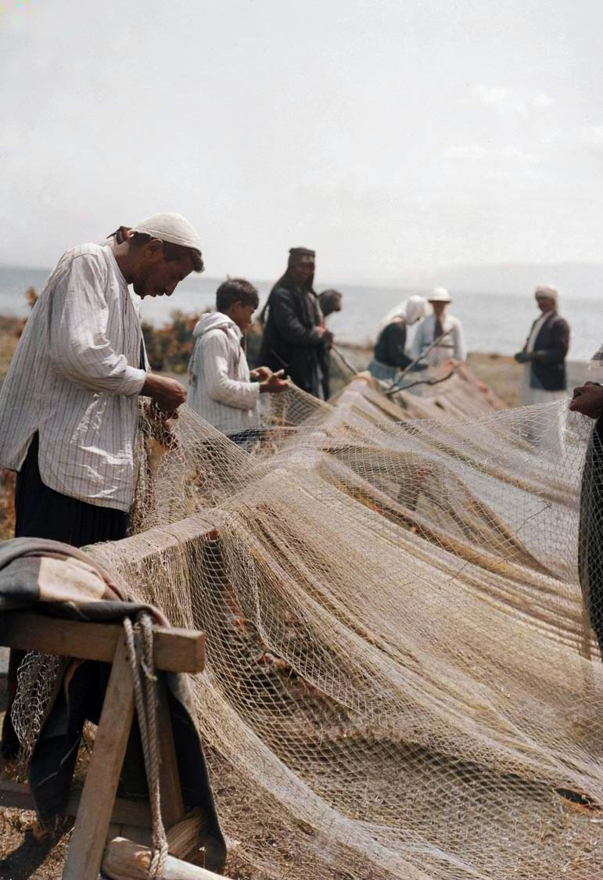
Fishermen mending their nets
Fishermen mending their nets
Notes:
Location of photograph: Sea of Galilee
Date of photograph: between 1934 and 1939
mat04162col

Slide 47
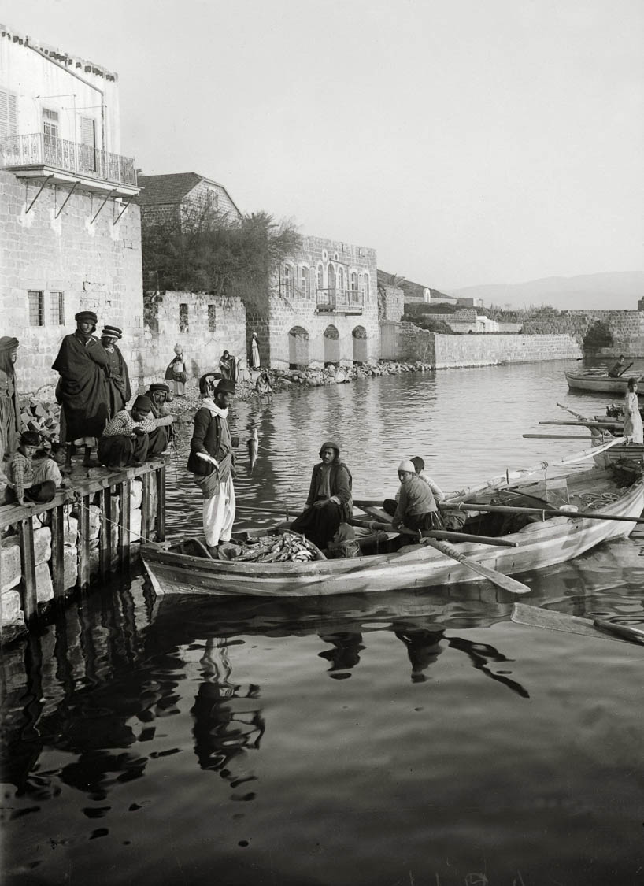
Boat filled with fish at Tiberias dock
Boat filled with fish at Tiberias dock
Notes:
“Fishing off Tiberias is only followed to a considerable extent during the winter and early spring months. It is not nearly so important as that along the northern shore from Mejdel to el Bataihah. The bay at et Tabaghah is, during the early months of spring, a wonderful place for fish; they swarm there, attracted by the copious hot springs which, loaded with vegetable débris, here pour their waters into the Lake. For about three months—mid-January to mid-April—the fisherman make this their head-quarters, erecting a few tents or reed huts on the shore, close to the mills. While the water a few yards out teems with larger fish, the shallows close in shore swarm with small fish-fry” (Masterman 1908: 41).
Date of photograph: between 1900 and 1920
mat05158

Slide 48
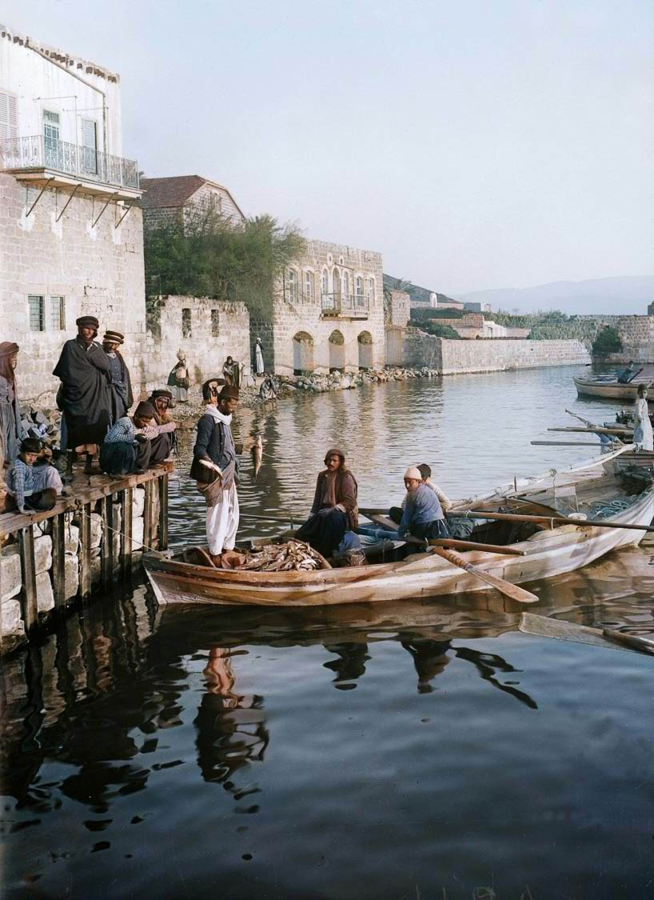
Boat filled with fish at Tiberias dock
Boat filled with fish at Tiberias dock
Notes:
“Fishing off Tiberias is only followed to a considerable extent during the winter and early spring months. It is not nearly so important as that along the northern shore from Mejdel to el Bataihah. The bay at et Tabaghah is, during the early months of spring, a wonderful place for fish; they swarm there, attracted by the copious hot springs which, loaded with vegetable débris, here pour their waters into the Lake. For about three months—mid-January to mid-April—the fisherman make this their head-quarters, erecting a few tents or reed huts on the shore, close to the mills. While the water a few yards out teems with larger fish, the shallows close in shore swarm with small fish-fry” (Masterman 1908: 41).
Date of photograph: between 1900 and 1920
mat05158col

Slide 49
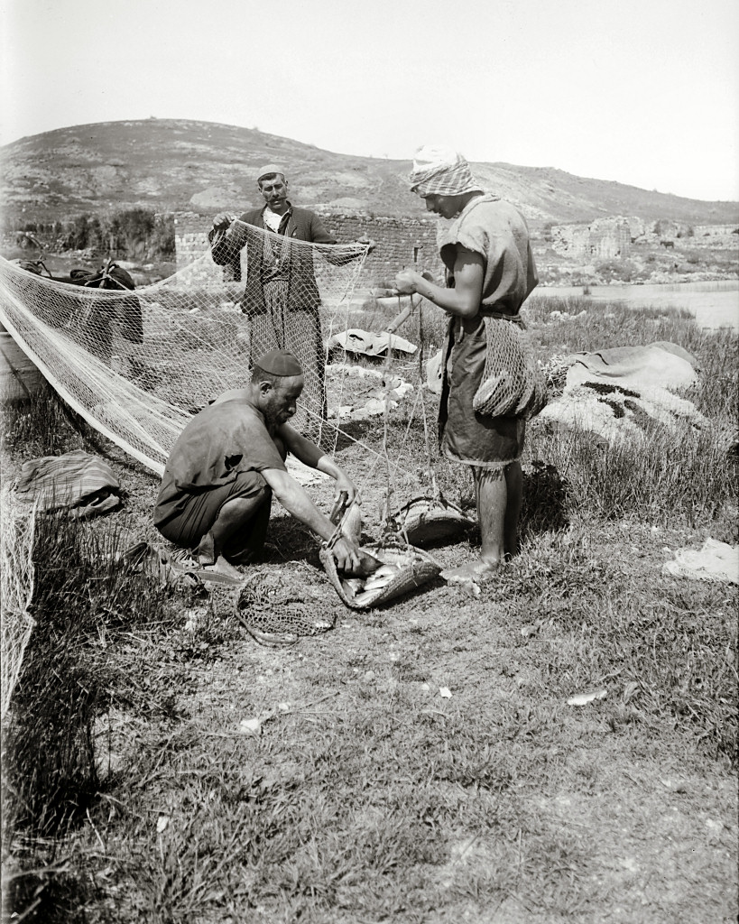
Fisherman selling fish in Tiberias
Fisherman selling fish in Tiberias
Notes:
Date of photograph: approximately 1900 and 1920
mat09008
49

Slide 50
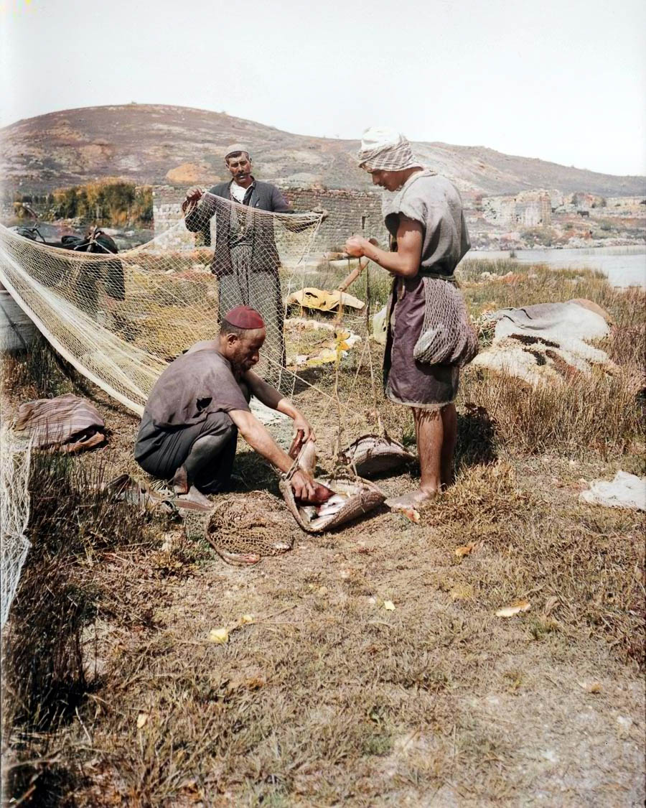
Fisherman selling fish in Tiberias
Fisherman selling fish in Tiberias
Notes:
Date of photograph: approximately 1900 and 1920
mat09008col
50

Slide 51
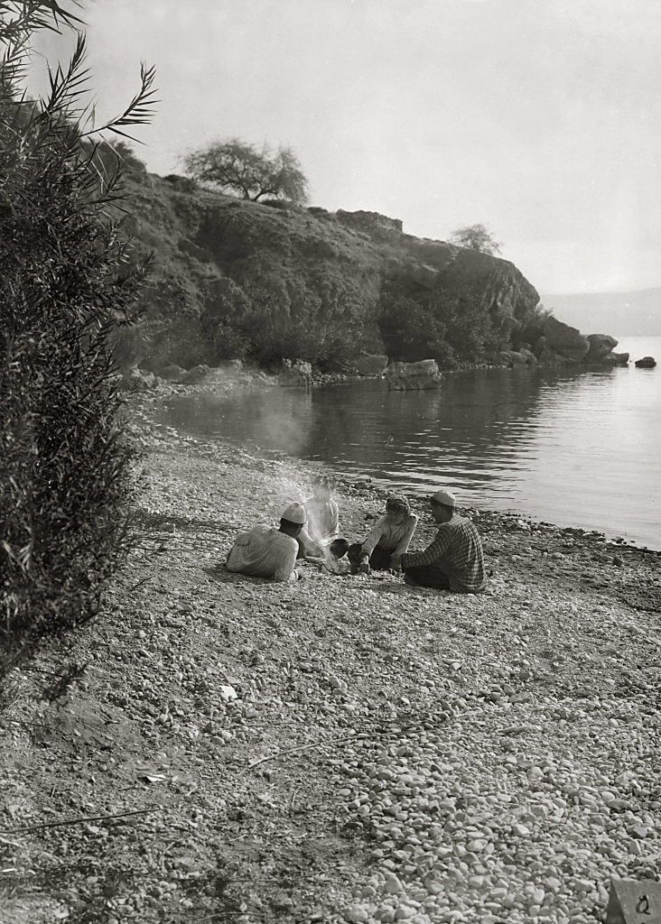
Fishermen on shore with fire of coals
Fishermen on shore with fire of coals
Notes:
John 21:9 (LSB) “So when they got out on the land, they saw a charcoal fire in place and fish placed on it, and bread.”
Location of photograph: Sea of Galilee
Date of photograph: between 1900 and 1920
mat05690

Slide 52

Fishermen on shore with fire of coals
Fishermen on shore with fire of coals
Notes:
John 21:9 (LSB) “So when they got out on the land, they saw a charcoal fire in place and fish placed on it, and bread.”
Location of photograph: Sea of Galilee
Date of photograph: between 1900 and 1920
mat05690col

Slide 53

Fishermen eating breakfast on shore of Sea of Galilee
Fishermen eating breakfast on shore of Sea of Galilee
Notes:
John 21:12–13 (CSB) “‘Come and have breakfast,’ Jesus told them. None of the disciples dared ask him, ‘Who are you?’ because they knew it was the Lord. Jesus came, took the bread, and gave it to them. He did the same with the fish.”
Bibliography
Mackie, G. M.
1898 Bible Manners and Customs. New York: Fleming H. Revell.
Masterman, E. W. G.
1908 The Fisheries of Galilee. Palestine Exploration Fund Quarterly Statement. Pp. 40-51.
Thomson, William M.
1882 The Land and the Book. Vol. 2: Central Palestine and Phoenicia. New York: Harper & Brothers.
Wilson, Charles, ed.
1881 Picturesque Palestine, Sinai, and Egypt. 4 Vols. London: J. S. Virtue & Co. Limited.
Date of photograph: between 1898 and 1946
mat09006
53

Slide 54

Fishermen eating breakfast on shore of Sea of Galilee
Fishermen eating breakfast on shore of Sea of Galilee
Notes:
John 21:12–13 ““Come and have breakfast,” Jesus told them. None of the disciples dared ask him, “Who are you?” because they knew it was the Lord. Jesus came, took the bread, and gave it to them. He did the same with the fish.”
Bibliography
Mackie, G. M.
1898 Bible Manners and Customs. New York: Fleming H. Revell.
Masterman, E. W. G.
1908 The Fisheries of Galilee. Palestine Exploration Fund Quarterly Statement. Pp. 40-51.
Thomson, William M.
1882 The Land and the Book. Vol. 2: Central Palestine and Phoenicia. New York: Harper & Brothers.
Wilson, Charles, ed.
1881 Picturesque Palestine, Sinai, and Egypt. 4 Vols. London: J. S. Virtue & Co. Limited.
Date of photograph: between 1898 and 1946
mat09006col
54

